Slide 1
Reflections on flexibility in power price scenarios

Slide 2
Webinar on September 18th, 2024
Internal Agenda
Review: Trend of Increasing Volatility in the Spot Market in Germany
Recap: Existing Flexibility Options and What We Need Them For
Outlook: Expected Development of Battery Storage, Heat Pumps, Electric Mobility, and Electrolyzer Capacity in Germany
Model Results: Improved Modelling of Flexible Demand and Results of Sample Years
Q&A

Slide 3
Volatility in the Spot Market in Germany

Slide 4
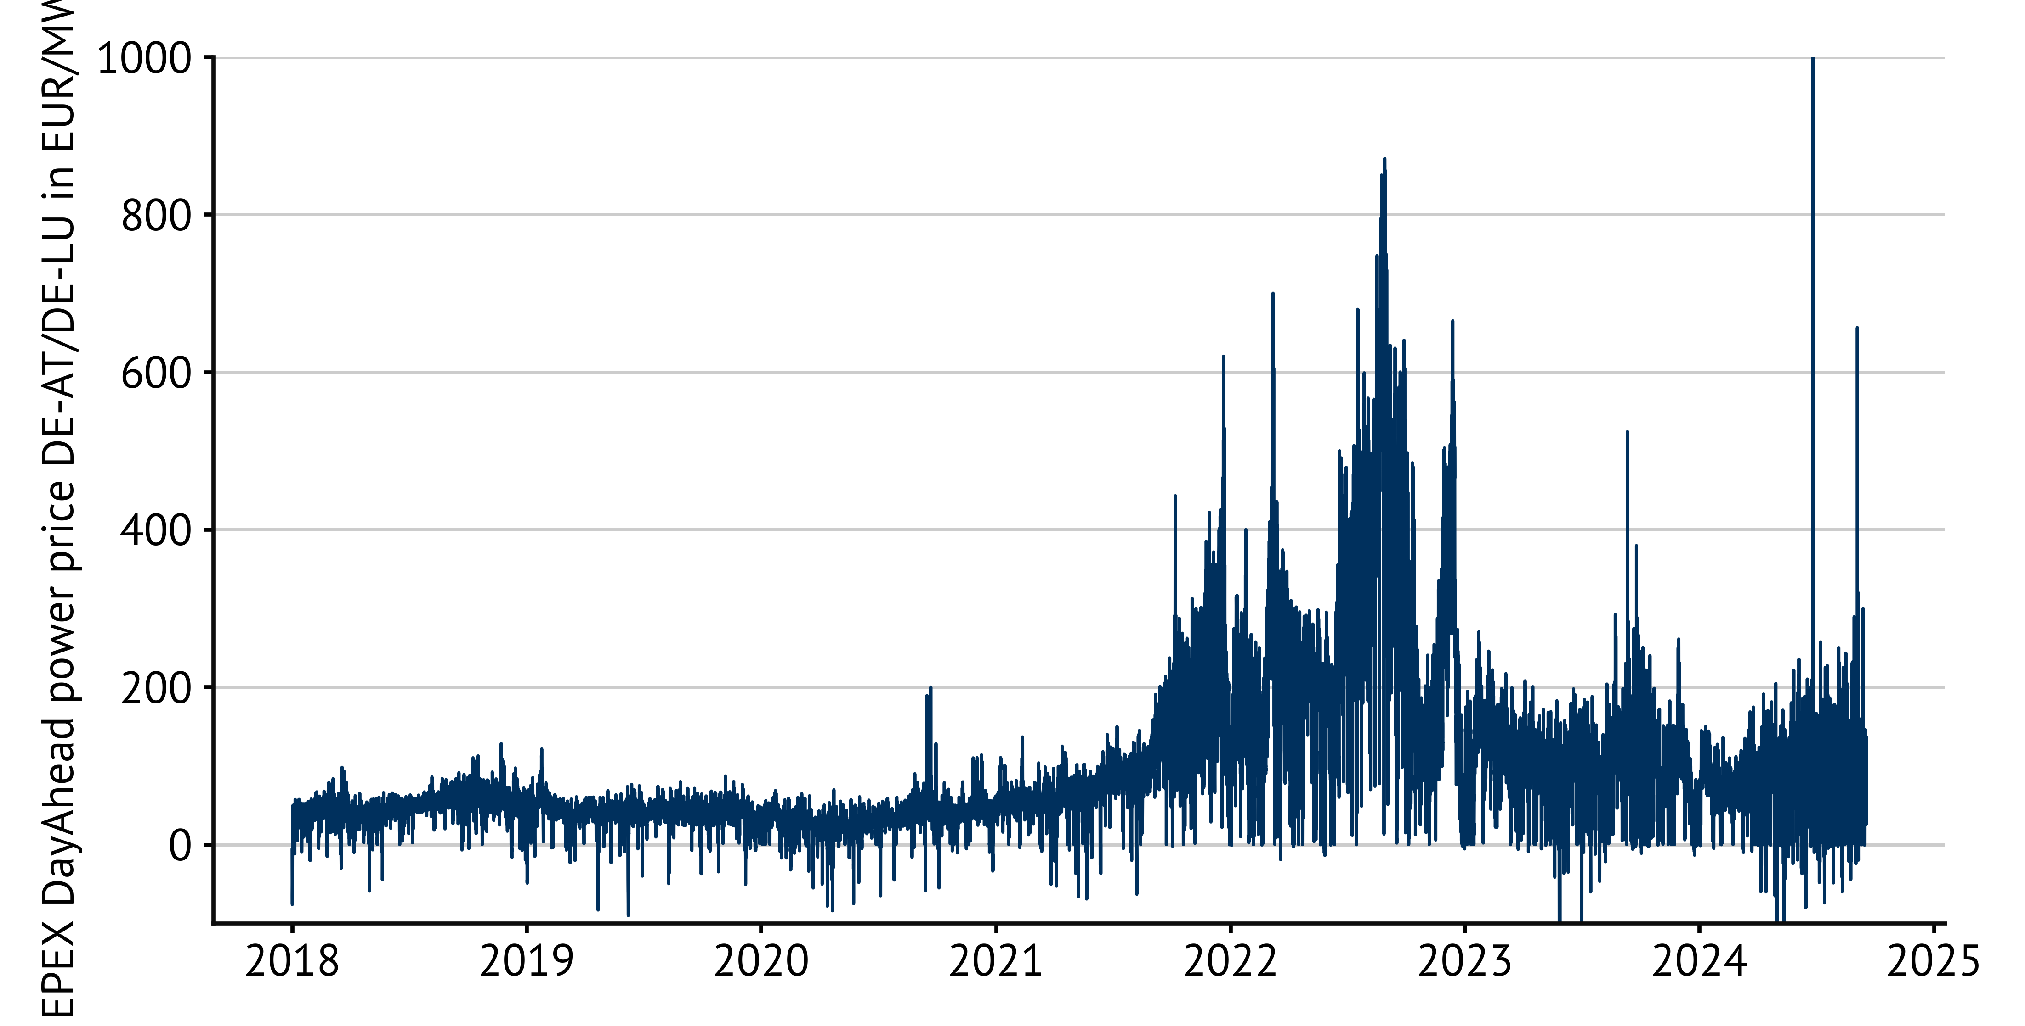
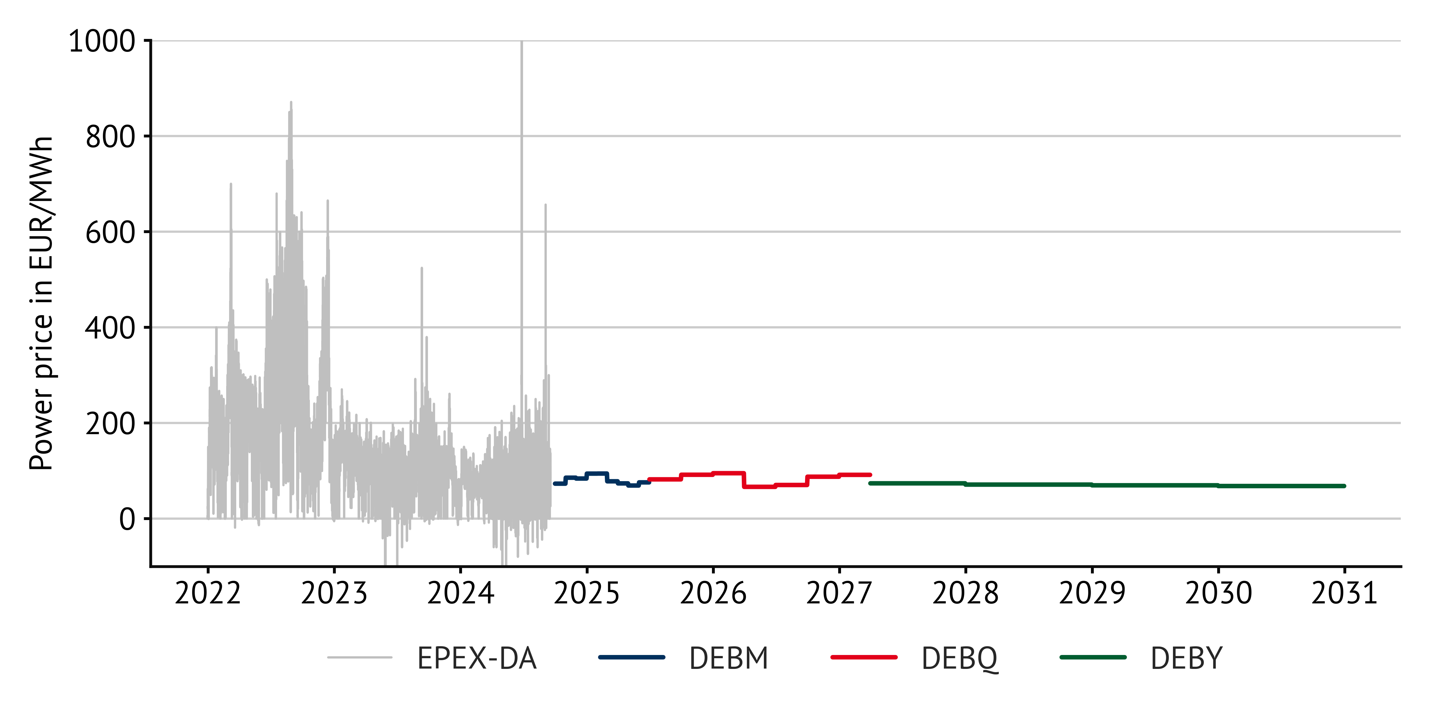
Power prices and PFC
Day-Ahead-Prices and Forward-Curve on trading day 28-08-2024
Data source: Energy Brainpool with data from EEX/EPEX
Notes:
Volatility has increased compared to pre-crisis levels
During the crisis we had enourmous volatility but not only due to RE
\\BE-SRV-02\Projekte_intern\EB (Analysen - eigene)\EEX_Terminmarkt_Strom_SQL.xlsx
Von Marketing zuletzt geprüft: Oktober 2019
Zuletzt aktualisiert: 07.11.2022, MaB

Slide 5
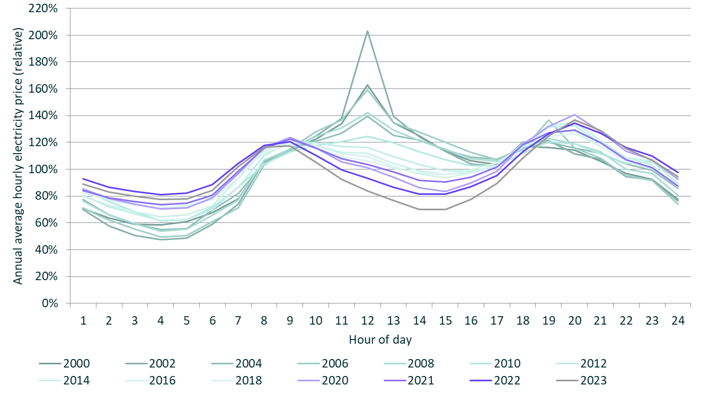
Daily Profile of Electricity Prices
The daily structure of spot market prices has turned from a peak into a valley
Spread is now lower
Storage could run two cycles
Sources: EPEX Spot, own calculations
Notes:
\\BE-SRV-02\Projekte_intern\EB (Analysen - eigene)\EPEX_Spotpreis-Tagesprofile.xlsx
No peak at noon anymore
Dent/dip due to solar power is observable
Menti: What happens at wholesale market when more renewables are feeding into the grid?

Slide 6
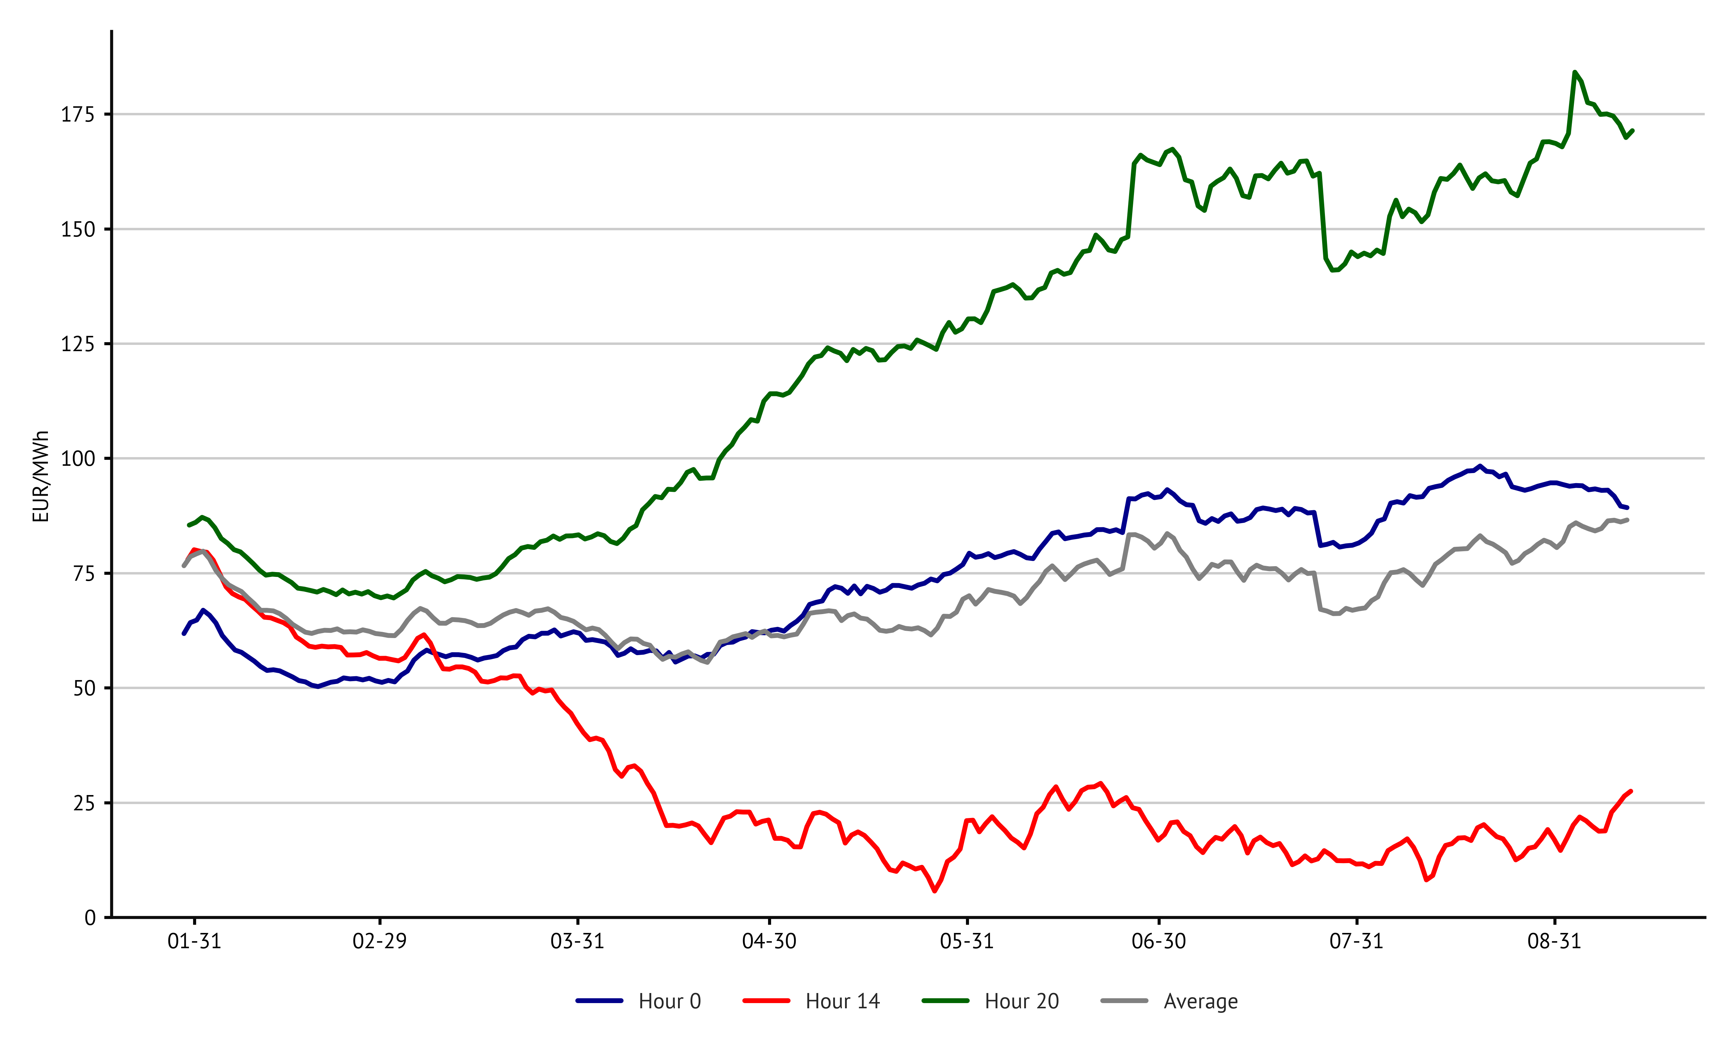
Price development - another perspective
?
Spot market prices for selected hours of the day
For 2024
Simple Moving Average
Spread between PV-peak and load-peak grows
Notes:
Question: number of spot market prices

Slide 7
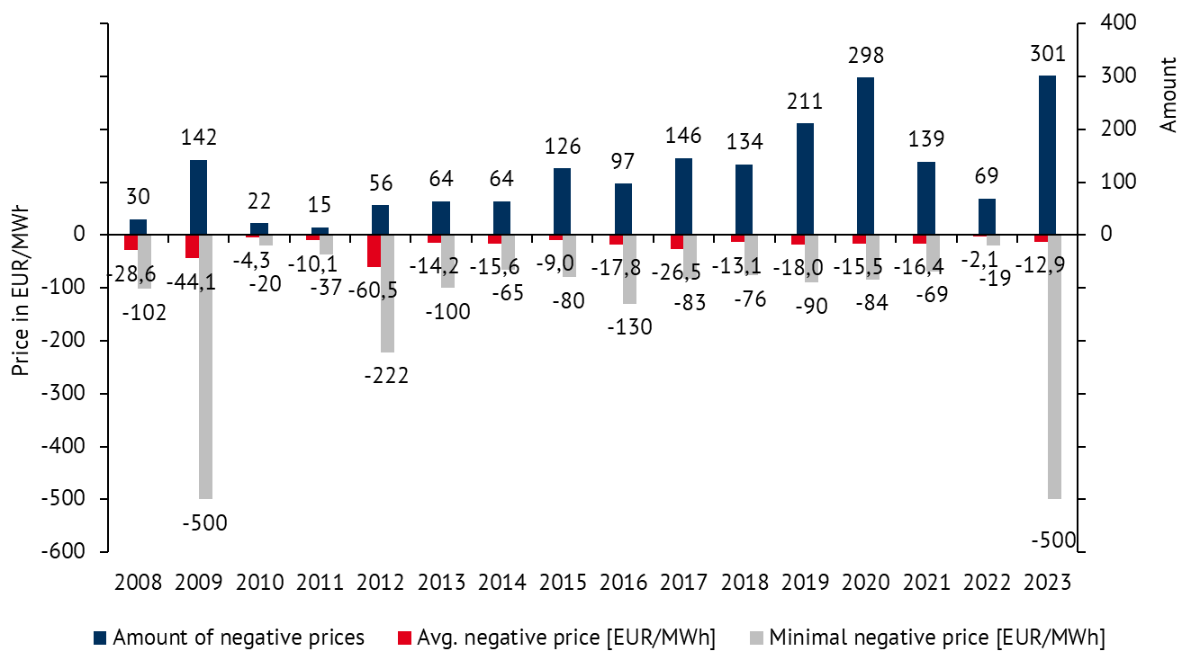
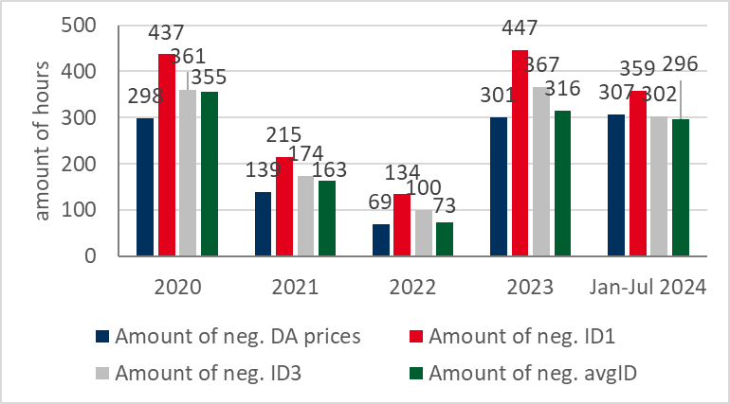
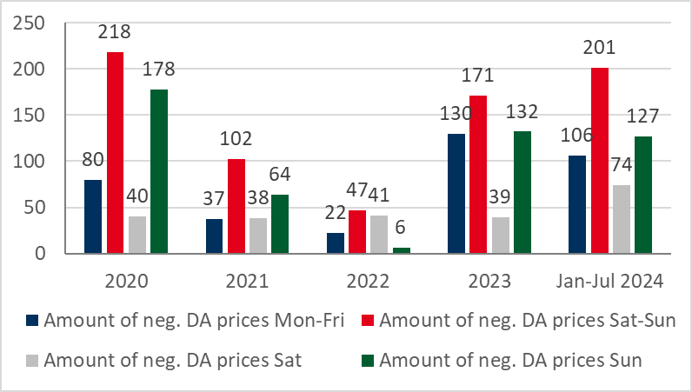
Development of negative Prices
Source: EPEX Spot, own calculations
Notes:
Almost 400 hours by today
Kernaussage:
Tonspur: 2020 was a year with lower demand (pandemic) and high RE feed-in, 2021 was a year with very low RE feed-in (especially from wind); perspective for the next years: fewer hours with negative spot prices as nuclear and coal exit progress and RE capacity needs time to catch up.
Interaktion (Menti/Whiteboard):
Quelle: \\BE-SRV-02\Projekte_intern\EB (Analysen - eigene)\POWER_SPOT_DA_negative_Preise.xlsb
Autor der Folie:
Zuletzt aktualisiert von/am: 17.01.2024, MaB
Hintergrundwissen:

Slide 8

Price fluctuations in the spot market
Development of fluctuating renewables
Current PV / Wind on / Wind off: 92 / 62 / 9 GW
Target PV / Wind on / Wind off: 215 / 115 / 30 GW
Remuneration scheme does not incentivize reaction to low prices (60 GW PV with fixed FiT)
Flexible demand still limited:
Battery storage
Electrolyzers
Heat pumps
E-mobility
Other flexible demand
Notes:
Whiteboard: total peak demand vs. PV installed

Slide 9

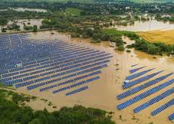

Volatility in the Spot Market in Germany
Examples of high volatility events
?
July 2nd, 2023 (solar excess): -500 EUR/MWh at DA Market
June 3rd, 2024 (flooding South Germany): +2000 EUR/MWh for ID1, over 9000 EUR/MWh for single bids, partly empty ask side
June 26th, 2024 (decoupling of markets): +2326 EUR/MWh at DA Market
Notes:
June 2023; 28 GW solar generation when prices were down to -500, load 44-46 GW midday
Flooding: two waves of flooding in south Germany

Slide 10
Existing Flexibility Options and What We Need Them For

Slide 11
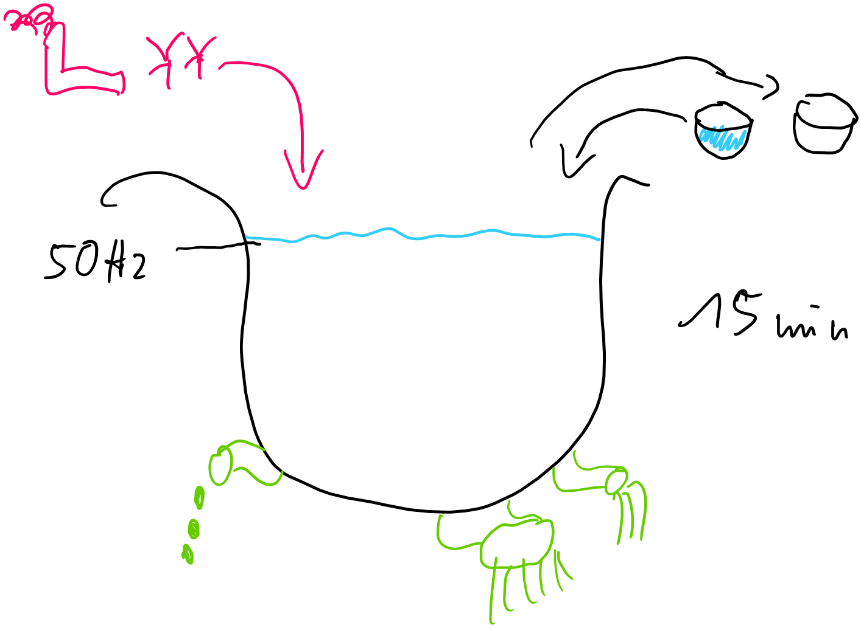
Balancing Supply and Demand
The bath tub + reserves

Slide 12
Flexibility options
Fluctuating renewable generation
Hydro power & biogas
Hydrogen/gas turbines
Inflexible demand
Dispatchable generation
Electrolyzer
Transmission grids & interconnectors
E-mobility
Flexibility options
Flexible demand
Grids
Heat pumps
Distribution grids
other
Storage systems
E-mobility (vehicle2grid)
Home BESS
Large-scale BESS
Notes:
Grid cross border capacity in 2024: approx 26 GW
Battery storage systems:

Slide 13
Expected Development of Battery Storage, Heat Pumps, Electric Mobility, and Electrolyzer Capacity in Germany

Slide 14
Expected Development:
Battery storage
Notes:
TYNDP – DE: Distributed Energy, GA: Global Ambition, NT: National Targets

Slide 15
Expected Development:
Electrolyzer
Bureaucracy too difficult
PPAs difficult to find
Additionality and simultaneous production & consumption in question

Slide 16
Expected Development:
Electric mobility
So far:
Germany as a late mover
No clear incentives, no passionate strategy, no effective support
Attempt to protect combustion engines
cars and charging stations: chicken and egg
Outlook:
Massive charging/discharging capacity
Temporary available, mobile

Slide 17
Target Development:
Heat pumps
Current status
2019: 19 GW installed capacity
Governmental goal:
500,000 installations each year from 2024 onwards
Assumption: 10 kW on average
New installations achieved
2023: 356,000
H1-2024: 90,000
2024 (expected): 200,000
Sources: Bundesregierung /BMWK, ZDF, Statista
Notes:
Compare 2040:
Batteries:
Ely: 40 GW
E-Mob: 3000 GW
HP: 110 GW

Slide 18
Total demand in our power price scenarios
?
Policy developments driving these changes?
EU Level
National Level
Local Level
Notes:
Is our path correct?

Slide 19
Improved Modelling of Flexible Demand in Power Price Scenarios

Slide 20
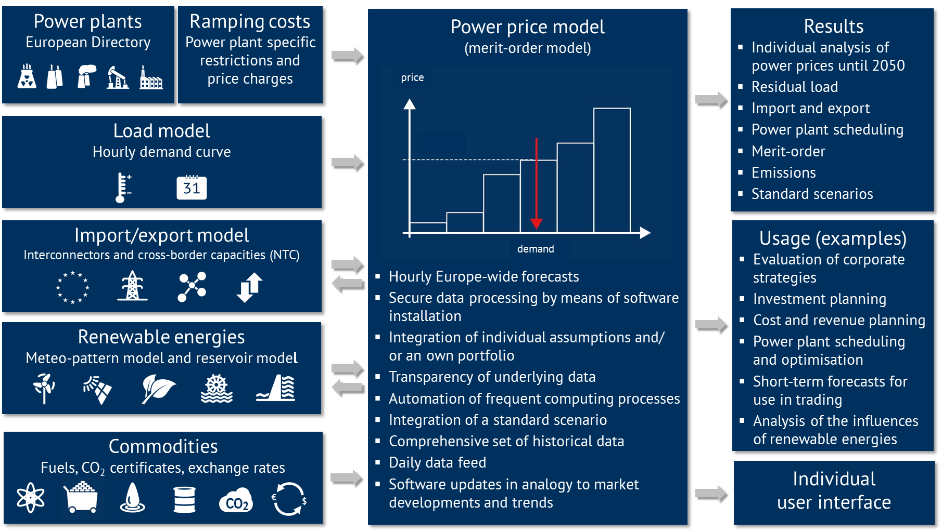
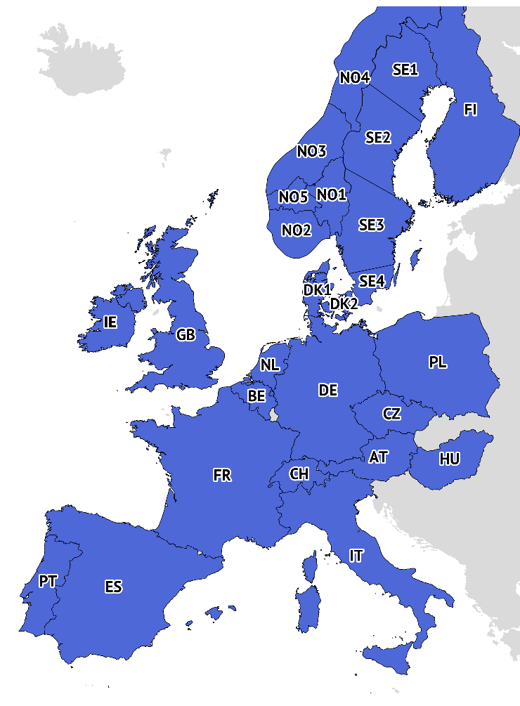
Model Structure & Functionality
EU-27 +
CH, NO, GB

Slide 21
Scenario Overview:
Developments in Europe
?
Scenario | Renewable energies | Commodity prices | CO₂ prices | Nuclear power stations | Coal fired power stations | E-mobility and PV-storage systems | Share of power generation in 2050 (2060) Emission free Renewables
„Central“ |  |  |  |  |  |  | 94 % (100 %) 76 % (77 %)
„Tensions“ |  |  |  |  |  |  | 90 % (94 %) 74 % (75 %)
„GoHydrogen“ |  |  |  |  |  |  | 100 % (100 %) 82 % (82 %)
Strong increase
Stable
Increase
Decrease, strong decrease
Notes:
In the "Central"scenario, it is assumed that as a result of the current tensions with Russia, Europe will stop importing Russian pipeline gas by 2027 at the latest. From 2027 onwards, the price of natural gas in Europe is determined by the world market price for LNG. In the long run, fossil natural gas will be substituted by synthetic fuels and in particular green hydrogen. The prices for hard coal, oil and EUAs are based on the „Announced Pledges“ scenario of the „World Energy Outlook 2023“, in particular with increasing CO₂ prices until 2050.
For the short-term price paths of fuel and CO₂ , the developments on the futures markets caused by the geopolitical situation are taken into account.
The scenario assumes a strongly decentralized energy system in the future with a considerable expansion of renewables, to reduce Europe's general dependence on fossil fuels imports in the medium run, and to eliminate it as soon as possible. This expansion is accompanied by an increase in the flexible demand for electricity.
The scenario „Tensions“ assumes that the current tensions between Russia and the west will continue and intensify in the coming years. As a consequence, Europe stops the imports of Russian pipeline gas as early as possible. The price of natural gas is subsequently determined by the world market price for LNG. European consumers are competing for LNG with Asian markets, which leads to a high natural gas price level also in the medium run.
The prices for hard coal, oil and EUAs are based on the „Stated Policies“ (coal and oil) and „Net Zero Emissions by 2050“ (EUAs) scenarios of the „World Energy Outlook 2023“. A sharp increase in CO₂ prices until 2050 is assumed both to generate additional revenues to refinance government debt, and to promote technological development for the applications of hydrogen.
In certain countries, for example in Germany, the scenario assumes a slower expansion of renewables than in the „Central“ scenario, due to skilled labour shortages and a lack of political support.
In the "GoHydrogen" scenario, it is assumed that the goal of Europe-wide climate neutrality by 2050 according to the EU Green Deal is achieved through the use of green hydrogen - as one of the main energy carriers in industry, transport and buildings. Electrification and the increased use of electrolysers to meet the demand for hydrogen will greatly increase the demand for electricity. This is mainly compensated by the expansion of renewables. With regard to commodity prices, a continuously rising price for CO2 emission certificates is the key element to create incentives for CO2-neutral technologies. After climate neutrality has been achieved, this price will be kept at a high level to penalise further CO2 emissions. Fossil natural gas is gradually replaced by hydrogen between 2030 and 2040, so that the gas price after 2040 is related to the world market price for green hydrogen. Since the other fossil fuels play a minor role in the GoHydrogen scenario, a strongly falling trend is assumed for the prices of hard coal and oil according to the "Net Zero Emissions" of the "World Energy Outlook 2023".

Slide 22

Recent changes
Revised modelling approach for Nordic price zones: Denmark, Norway and Sweden include zone-specific modelling. The individual bidding zones of Denmark (DK1 and DK2), Norway (NO1 to NO5) and Sweden (SE1 to SE4) are modelled as separate markets in our electricity price scenarios.
Country-specific updates to the assumptions for the Nordics and Eastern Europe: In Northern and Eastern Europe, the assumptions for emission-free generation technologies (nuclear, renewables and H2-ready gas turbines) and flexible demand have been adjusted in line with new government statements on energy policy.
Revised flexible demand modelling: Our approach to modelling flexible demand includes the future development of heat pumps, electrolysers and electric vehicles separately.
Notes:
Revised modelling approach for Nordic price zones: From this update, all our country reports for Denmark, Norway and Sweden include zone-specific modelling. The individual bidding zones of Denmark (DK1 and DK2), Norway (NO1 to NO5) and Sweden (SE1 to SE4) are now modelled as separate markets in our electricity price scenarios. Due to temporary interruptions in domestic transmission capacities, particularly in Sweden and Norway, there have been significant zonal price differences in the Day-Ahead market in recent years.
Country-specific updates to the assumptions for the Nordics and Eastern Europe: In Northern and Eastern Europe, the assumptions for emission-free generation technologies (nuclear, renewables and H2-ready gas turbines) and flexible demand have been adjusted in line with new government statements on energy policy. There is currently a recognisable trend in many countries that the expansion of renewables (especially solar and wind) is no longer being pushed as progressively as before in the new government declarations, but rather the expansion of emission-free conventional generation capacities such as nuclear power and gas turbines is being discussed.
Revised flexible demand modelling: Our approach to modelling flexible demand includes the future development of heat pumps, electrolysers and electric vehicles. The further development of this approach can better reflect the different degrees of flexibility of these three applications.

Slide 23
Let‘s play!
What would happen to the power price, if flexible demand was…
a. 50% lower
Next 10 years: power prices increase significantly
Beyond 2035: almost no change in power prices
b. 50% higher
5 to 10 % reduction of power prices

Slide 24
Reasons for price variatons
2030: variation of prices especially in winter
Due to days/weeks with darkness + no wind (Dunkelflaute)
With Low-Flex, more generation from expensive generation or imports needed
2040: variation of prices especially in summer
With High-Flex, more power shifted to low-price hours (PV peak hours)
With Low-Flex, less power shifted to low-price hours (PV peak hours)
Notes:
Key figures to add:
2030: up to 40-50% higher prices in some winter months if flex-demand is 50% lower
2040: up to 50% lower prices in some summer months if flex-demand is 50% higher

Slide 25
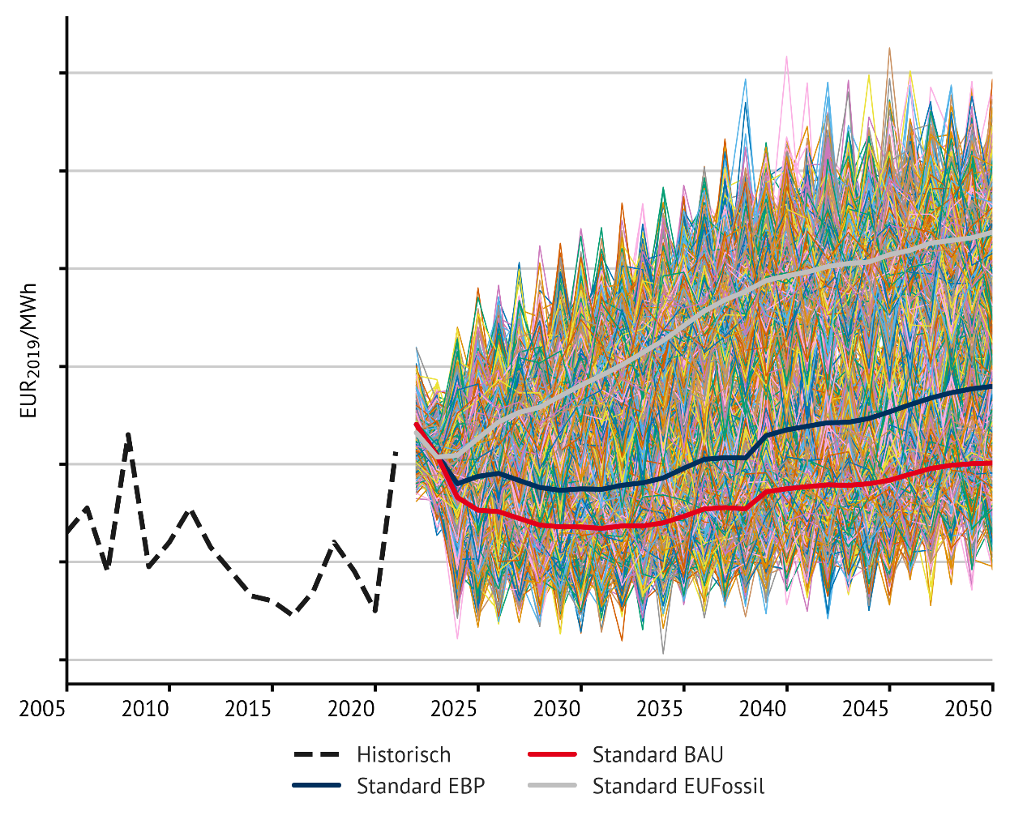

Scenario-Swarm to Quantify „known unknowns“
1000 Scenario Runs around a basis scenario
Known unkowns:
Weather
Market volatility (economic upswings and shocks, commodities)
Beyond long-term trends, we know there will be volatility (e.g. 2020 vs. 2021)
Notes:
Die Strompreisszenarien in den BrainReports sind eine Mittelwertschätzung (Median/P-50), für ein gegebenes Set an Input-Parametern; aber wie hoch ist das Preisrisiko? Wie hoch oder niedrig können Strompreise ausfallen, wenn es anders kommt, und was sind die damit einhergehenden Wahrscheinlichkeiten?
Monte Carlo Simulation mit ~3000 Szenarioläufen.
Die Modelparameter (Wetterjahre, Stromnachfrage, Rohstoffpreise) werden für jeden Lauf aus einer gegebenen Verteilung zufällig gewählt.
Auf diese Weise können wir Aussagen treffen über die zukünftige Verteilung von Strompreisen, Vermarktungswerten und –mengen, Extrempreisen etc., sowie Abschätzungen hinsichtlich eines „low case“ (z.B. P-90) machen.
Calculation of scenario-swarm with n = 1.000 each scenario
For every n:
Choose a random* sequence of weather years
Choose a random* sequence of deviations of commodity-price-trend
Choose a random* deviation of electricity demand
Evaluate every single scenario and use the scattering of results to generate probabilities

Slide 26
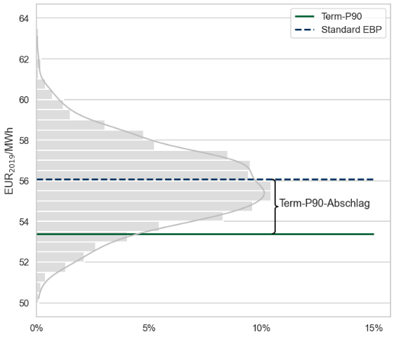
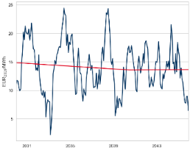
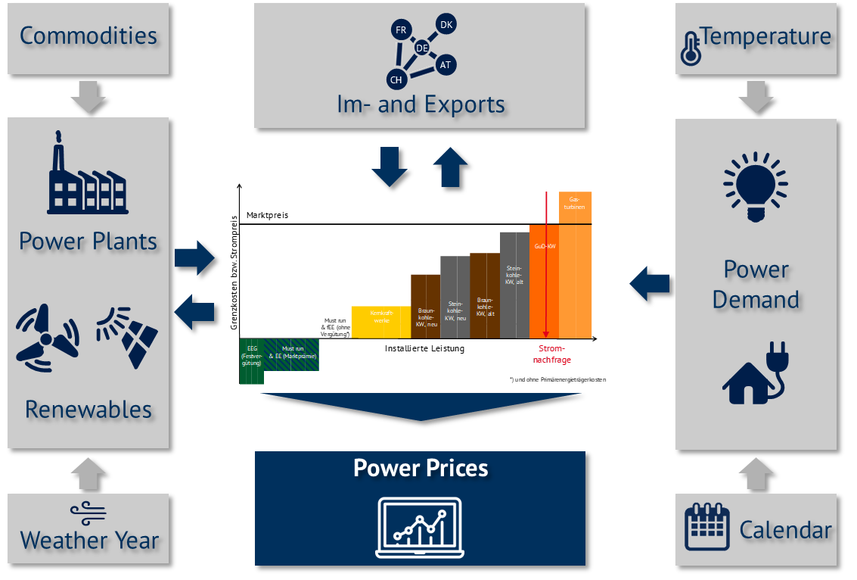
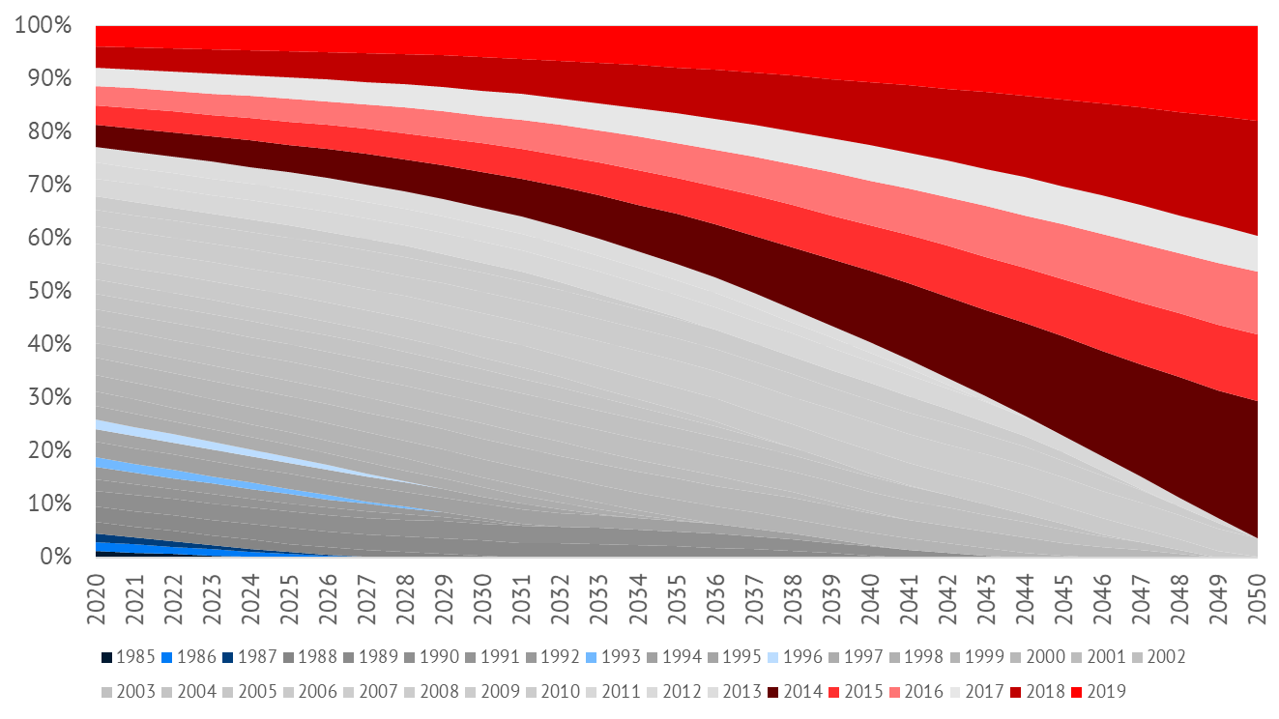
Energy BrainSwarms: Methodological Approach
Randomly drawn
model parameters
Fundamental Scenario-swarm simulation
Distributions
Commodity prices
Simulation run #1000
Power demand
Simulation run #…
Simulation run #2
Simulation run #1
Weather years
“short-term noise“…
…within the pillars of a future energy system

Slide 27
What questions do you have?

Slide 28


Thank you!
Matthis Brinkhaus
Senior Expert
Energy Brainpool – part of the Montel Group
Matthis.Brinkhaus@montelgroup.com
+49 162 9295900

