Slide 1
Managing Volatility in Short Term Markets
03 December 2024
Jean-Paul Harreman
Director Montel Analytics

Slide 2
Agenda
Introduction
Why is volatility Increasing?
Introducing the Short-Term Analysis Sequence
Forecasting Challenges
Auction results & Rebalancing Portfolios
Delta Tracking
Continuous Trading & Balancing
Forecasting Intraday Markets

Slide 3
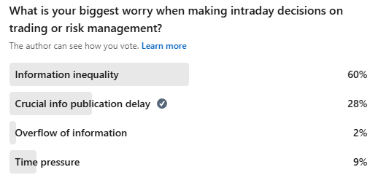
Poll Results

Slide 4
Increasing Volatility

Slide 5
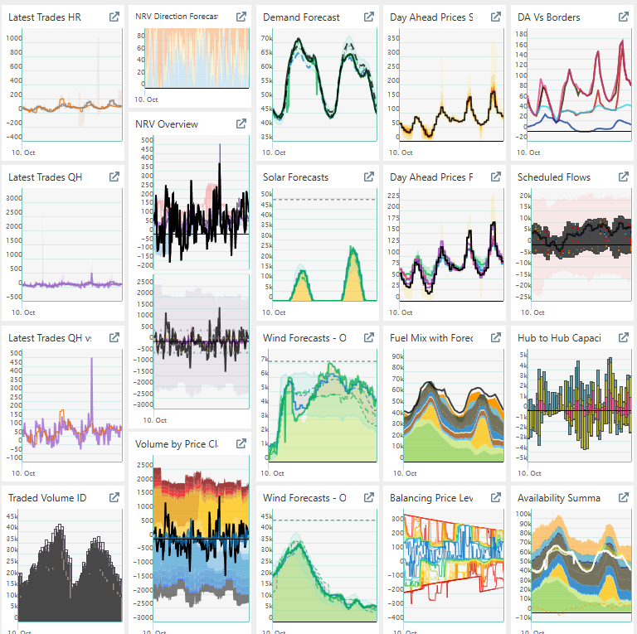
Why Is Volatility Increasing?
Increasing Renewable Generation – Weather Dependency
Decreasing Flexible Generation (Fossil) – Fuel & Carbon Cost
Renewable Generation does not follow Demand – Timing Gap
Need for Flexibility growing faster than Build-out of Flexibility
Market Coupling, Balancing Harmonization dampen the impact, but are not a magic cure.

Slide 6
What does that mean for the future?
Short-Term portfoliomanagement continues to become more important
The value of flexibility will continue to grow
Assessing the potential for volatility of power prices is crucial to manage risk and opportunities
Managing risk starts early: Once forecasts become usable for expectations of demand, supply and the price impacts, you can start positioning your consumption, power production, to reduce your exposure to risk, or increase the potential to capture opportunities
However, this is not a ‘one-shot’ process, you can continuously improve until the moment of delivery. It takes effort!

Slide 7
Short Term Analysis Sequence

Slide 8
Introducing the short-term analysis sequence
As the day of delivery comes closer you can start to form an expectation about demand, supply and prices, but also about potential volatility, which translates into risk or opportunity.
Weather forecasts go forward very far, but for your short-term optimization, usually about 3 days ahead is sufficient for your analytics.
This allows a generator to foresee if a plant needs to be online and if it will be able to have a good chance of making a profit.
A consumer with flexible consumption can schedule manufacturing processes around the most favorable times.
A trader will be able to see how the shift from financial markets to physical markets may materialize.

Slide 9
Steps in the Sequence
Forward Market
Ancillary Services Market
Day Ahead Market
Intraday Market
Balancing Market
Risk Neutral Hedging
Y-3, to D-1
D-1: 9:00
Financial Risk Mitigation
D-1: 12:00
D-1: 15:00 to delivery
Active Risk Reduction/Opportunity Capturing
Real-Time
Weather Forecasts, 6-hourly model runs
Derived Insight from Fundamentals: Available Flex, Ramps, Uncertainties, Sensitivities
REMIT/Outages/Availability of assets, infrastructure
Fundamental Price/Generation Models
Accepted Prices
Supply/Demand Curves
Rebalancing Needs
Ancillary Services Insights
Day Ahead Auction Insights
Intraday Auction Insights
Market Depth
Market Sensitivity
Traded Volumes
Forecast Delta Tracking
AI/ML Modelling
Ultra-Short-Term Forecasting/Nowcasting
Continuous Trading Insights
Cross-border Capacity
Continuous Trading Prices/Trends
Balancing Market Insights
Balancing Energy Bid Curves
Balancing Activation Data

Slide 10
It starts with a weather forecast
Weather forecasts provide a good sense of direction for consumption and renewable generation potential.
Note that in today’s markets, a weather forecast alone is not sufficient to forecast renewable generation.
Average weather is no longer very useful for short-term optimization, we need to have an idea of wind and solar levels, but also the timing is import.
The market settles in 15-minute granularity, total daily production or market share of renewables is less important when we get closer to physical markets.
MW at a certain point in time are more important than total MWh

Slide 11
Forecasting Challenges

Slide 12
The demise of the point forecast
Over the years weather forecasts have become more accurate, with the arrival of ai-forecasts, we can expect a further improvement.
Assessing the quality of a forecast on the short-term, goes further than just looking at one line, or one point that is forecasted.
The volume deviation of a forecast is easy to measure, but what we are really interested in, is the range of potential deviations.
A small deviation may have a large price impact, and a large deviation may have a small impact. It is important to rate the quality of a forecast on multiple variables, depending on what you are using it for.
A forecast that does not always capture the best performance in MAE, may add valuable insights in potential price volatility.

Slide 13
Probabilistic Forecasts in Practice
While a probabilistic forecast, looking at the impacts of outliers in demand, renewable forecasts or even price forecasts, may not produce the exact outcome of the market price. There is a lot of value in having different scenarios after the price is known.
The next markets in sequence are again exposed to weather changes, power plant outages, and cross-border influences.
The “what if”-aspect of probabilistic forecast is priceless when the market changes in real time.
If there is a risk-bias, this helps shapes your thoughts about portfolio-management.

Slide 14
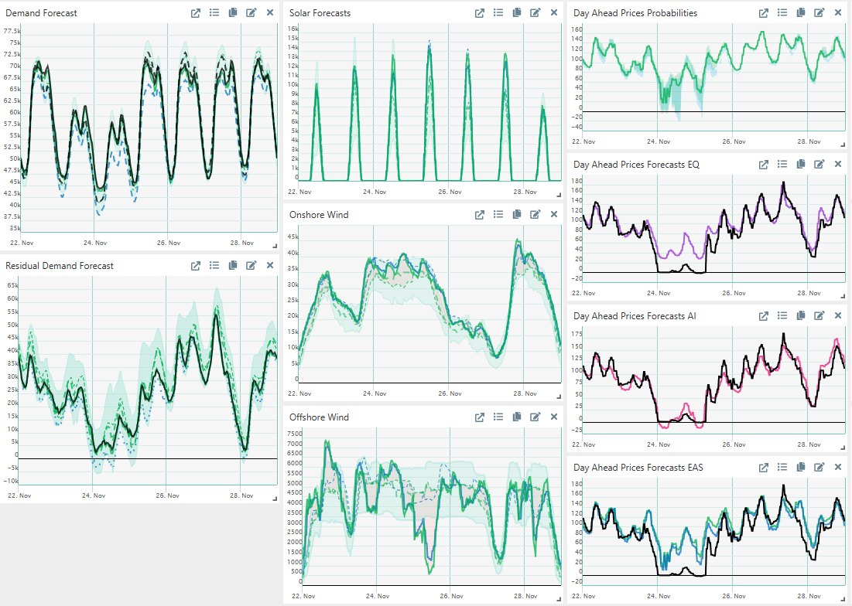
Forecast Uncertainty
If probabilities are symmetric, the most likely forecast is usually a good starting point.
Asymmetric signals risk/opportunity and a potential to introduce a slight bias into your position management, to reduce financial risk or increase potential revenue.
Different modelling methodologies add significant value.

Slide 15
Feedback Loops:
Auction Results

Slide 16
Auction Results
Auction results tell us a lot about market depth, the volume available at different price levels
The more moderate the auction curves, the more stable the market will be, even if the weather changes or there are other incidents
The inherent stability of short-term markets can be derived from the various auction results
Ancillary services auctions determine how much flexibility will be available and the prices in the curves tell us how the balancing parties value the flexibility. These auctions run before the Day Ahead auction and give you valuable information.
Energy Auctions (Day Ahead, Intraday) tell us who is in the market at which price and what the price would have been in different scenarios.

Slide 17
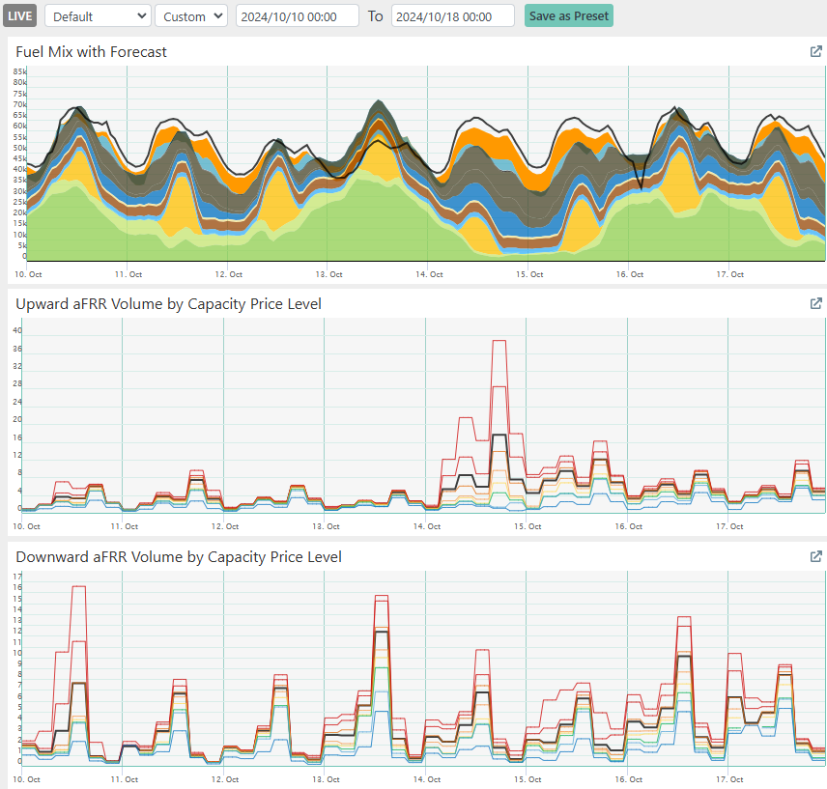
Ancillary Services
Capacity Auctions
Capacity prices are an early indicator for fuel mix, available flexibility and ability of the market to cope with changing circumstances.
Downward flexibility is often more valuable during low fossil fuel generation.
Upward flexibility has more value during high fossil fuel generation.
Ramping (sharp drop or increase in renewables or fossil) add value to both upward and downward flex.
Evening Ramp
Solar peak

Slide 18
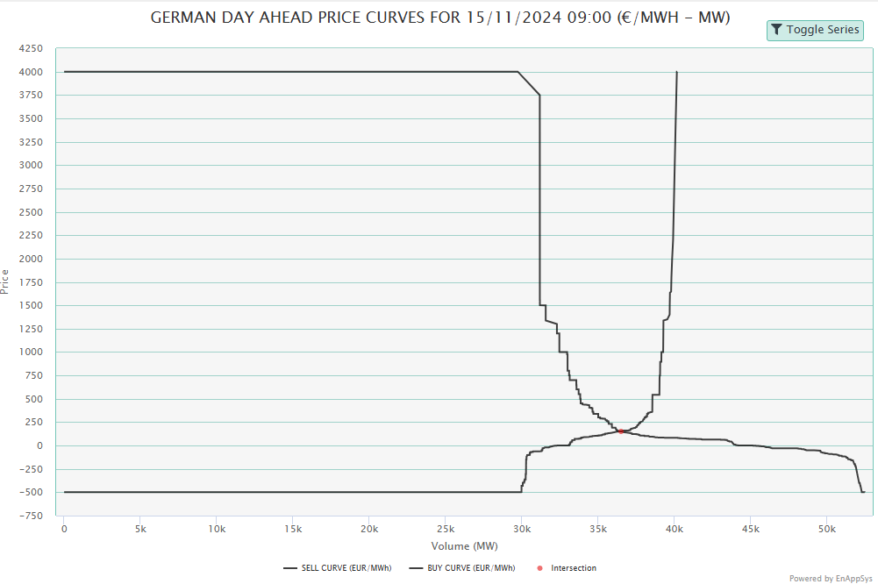
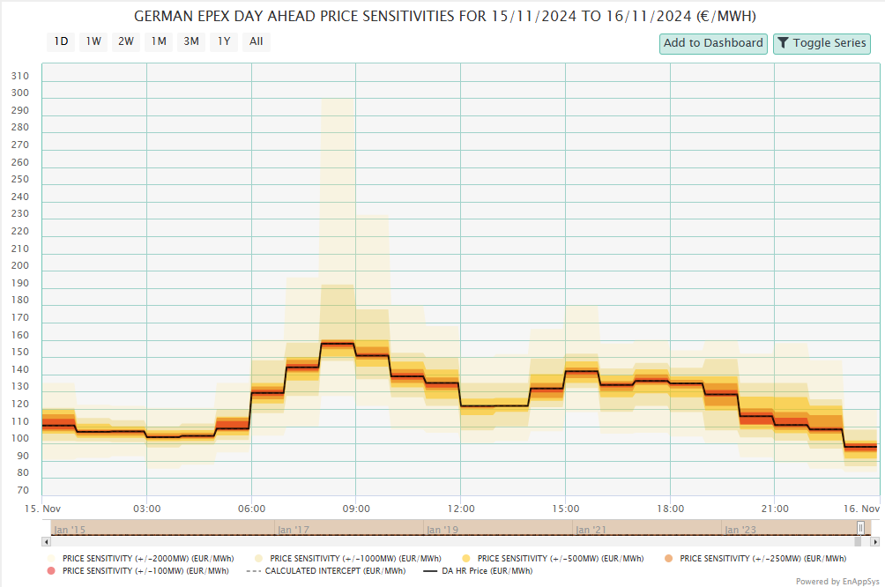
Day Ahead/Intraday Auctions
Must-buy demand
Supply and demand curves provide market depth information
Shifting the curves with fixed intervals provides an insight into the sensitivity of the market for use in intraday
As the fundamentals have usually not changed massively versus the auction time, this shows the potential impact of increased demand, reduced renewables, etc…
Make or Buy Range
Must-sell generation

Slide 19
Rebalancing Portfolios

Slide 20
Rebalancing Hourly Profiles
As the Day Ahead auction clears in hourly blocks, some shaping needs to be done afterwards to ‘convert’ positions to ‘market resolution’ of 15 mminute periods.
The deltas we see on the IDA 1 auction versus the hourly averages, tell us what the market sees as the progression of volume and price over the different periods of the day.
Counterintuitive deltas point at sharp ramps of renewables or demand, vs fossil fuel generation.
Exaggerated deltas point towards a high sensitivity and should be a warning to watch those periods on the continuous intraday market.

Slide 21
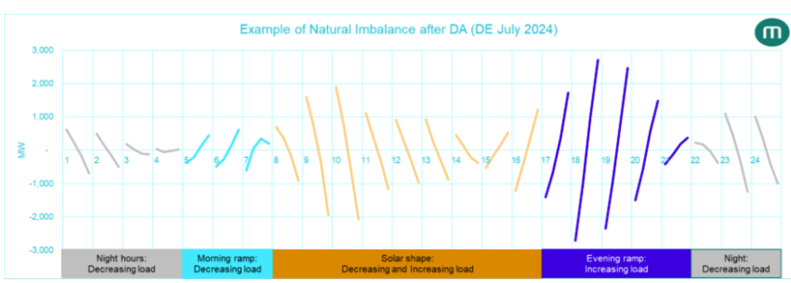
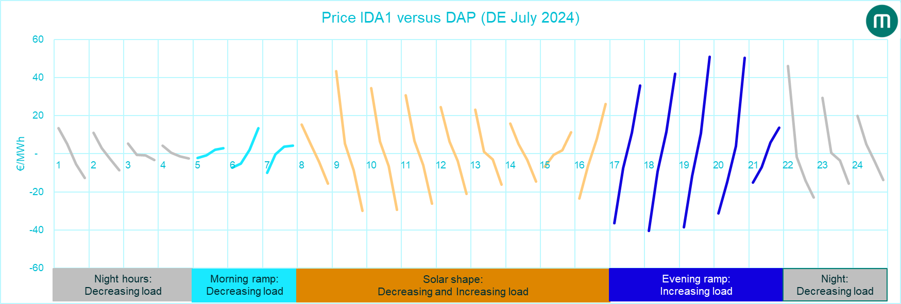
Rebalancing to quarter hours
Intraday auctions are the first opportunity to rebalance portfolios to quarter hourly profiles
This rebalancing, splits hourly profiles into fractions, in function of solar, renewables, demand and other factors
The first intraday auction deals with this profiling whereas IDA 2 and IDA 3 deal with forecast deviations
The charts shows average profiles, deviations will stand out!
Volume Delta vs Hourly Average
Volume Delta
Price Delta IDA1 vs Day Ahead
Price Delta

Slide 22
Feedback Loops:
Delta Tracking

Slide 23
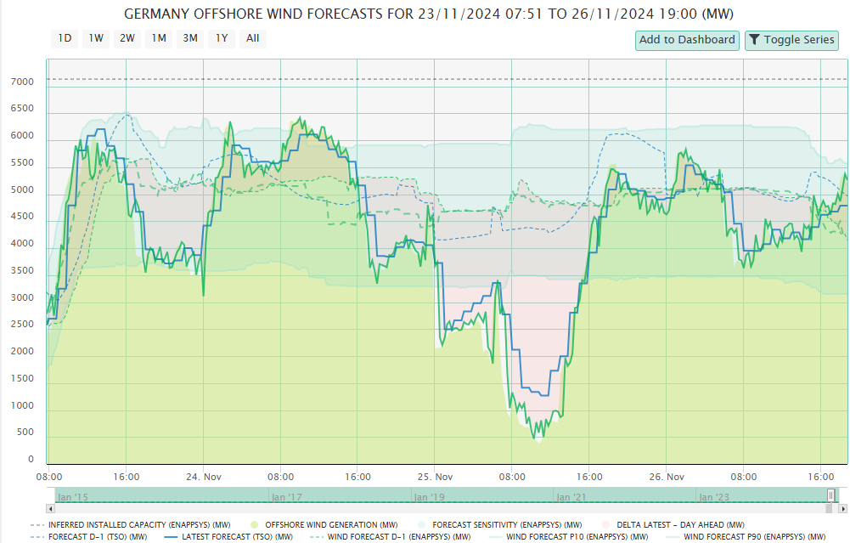
Delta Tracking
Weather models run every 6 hours, but renewable generation is no longer just dependent on weather.
Transmission issues, price sensitive bidding, affect generation profiles
Monitoring the measured values for demand, solar, wind as a feedback to forecasts.
  It is key to understand if a deviation as a “level” delta, a “timing” delta.
Montel Analytics uses ML models to determine cause and potential evolution in the next hours to help you make sense.
Day Ahead Forecast
TSO Forecast
Montel Forecast

Slide 24
Feedback Loops:
Real Time Market

Slide 25
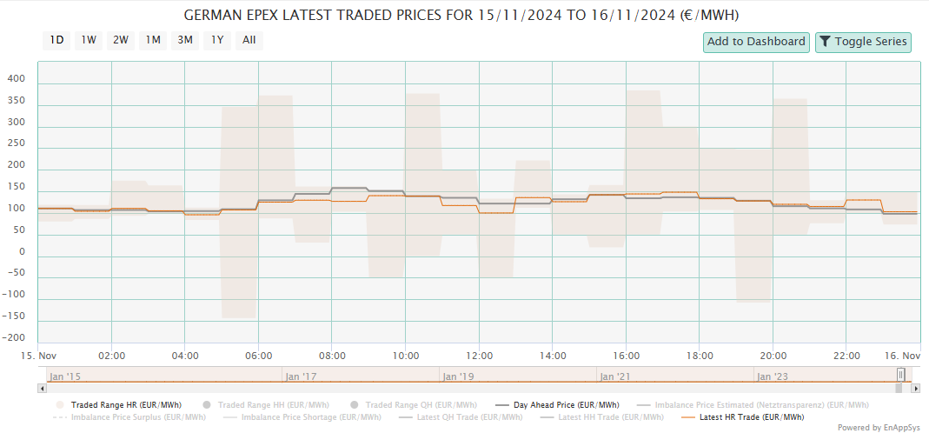
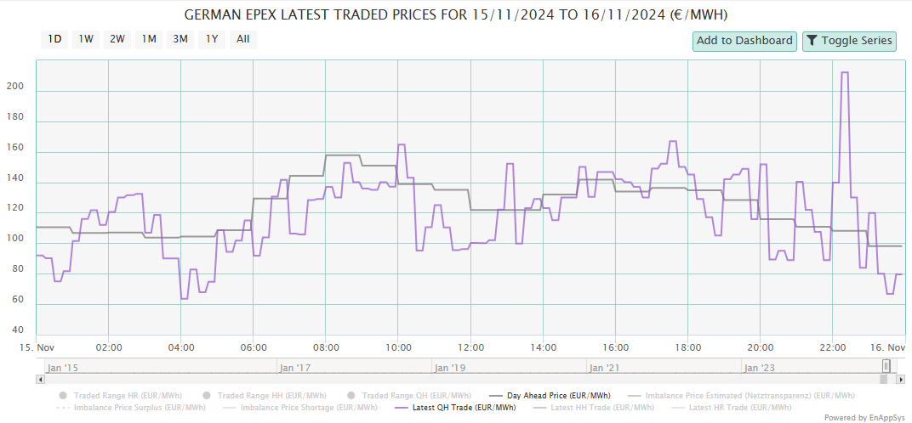
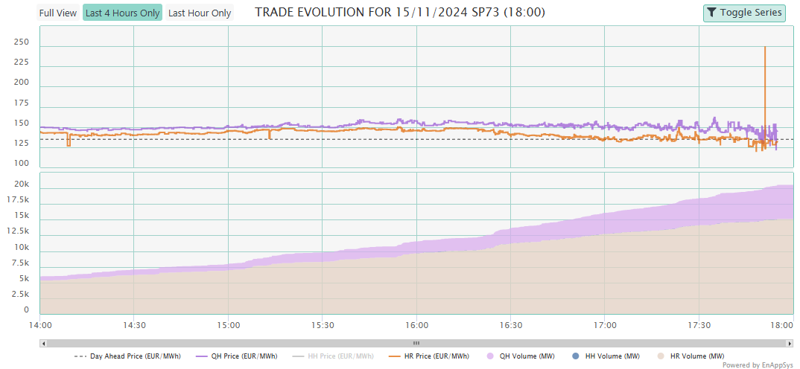
Feedback Loops:
Continuous Market
In real-time, the continuous market and the information around the balancing market becomes more important
Looking at the hourly and quarter hourly trade evolution you get an idea of sentiment and liquidity
Zooming in to period-level, allows you to see more details and assess volatility and risk
Trade history single period
QH Price
HR Price
QH Volume
HR Volume

Slide 26
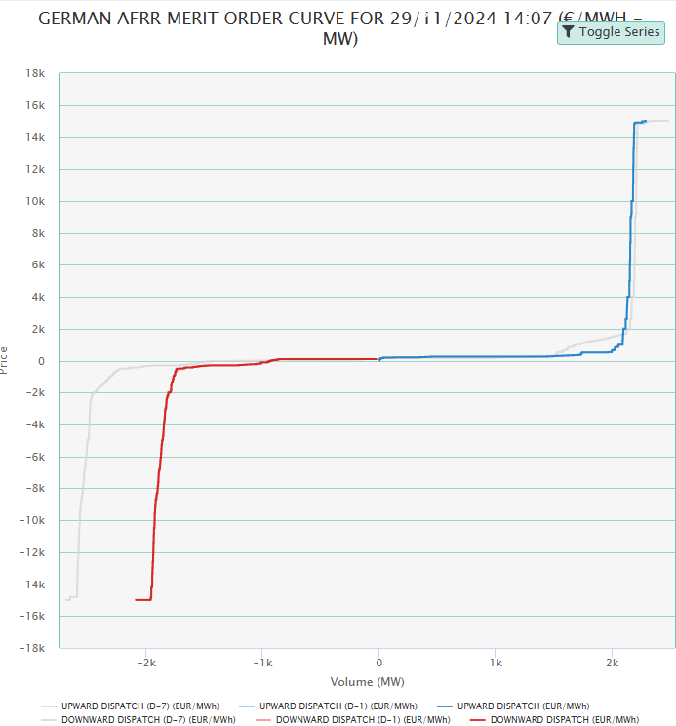
Feedback Loops:
Balancing Market
Balancing bids are published shortly before delivery.
These bids give you an insight in shortage and surplus prices and the market depth of the balancing market.
Looking at similar periods of previous days, provides an insight into the periods that are not published yet.
Curves are difficult to use in real time (96 curves per day)

Slide 27
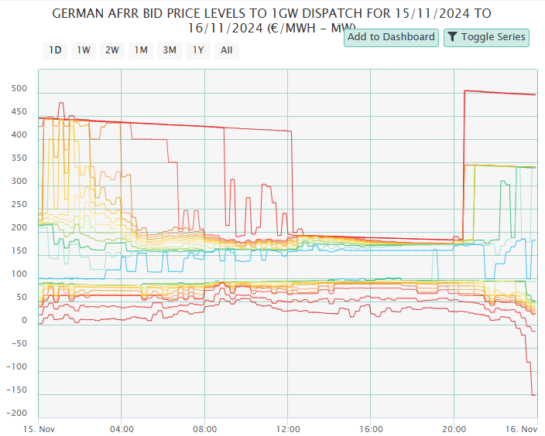
Feedback Loops:
Curves to Time Series
Translating a curve into a chart that is easy to read.
Shows trends in market depth of the balancing market in each direction.
Bringing this all together in a dashboard allows you to follow all the trends at a glance.

Slide 28
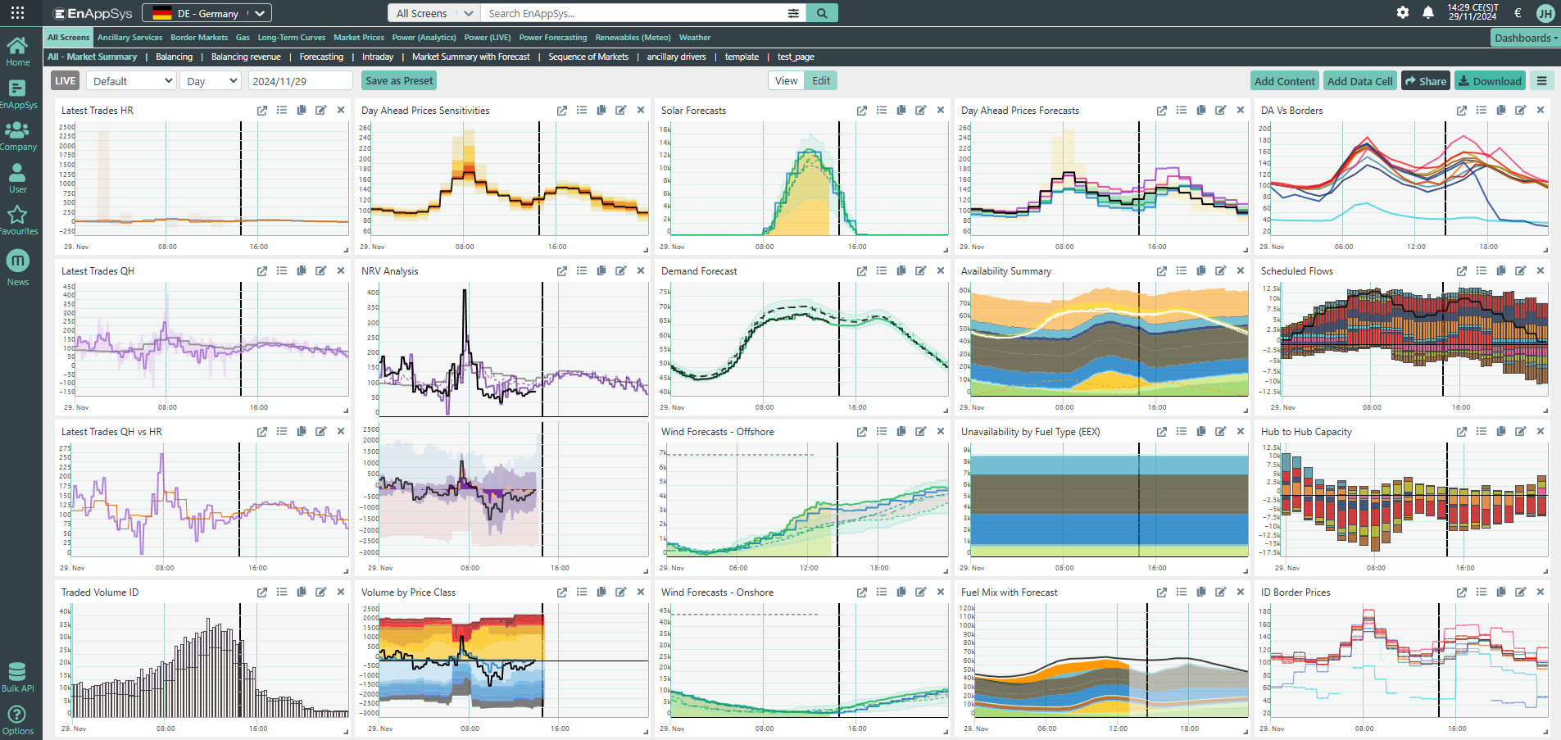
Intraday Live Dashboard
Sensitivity
and tight
Balancing market

Slide 29
Forecasting the intraday market

Slide 30
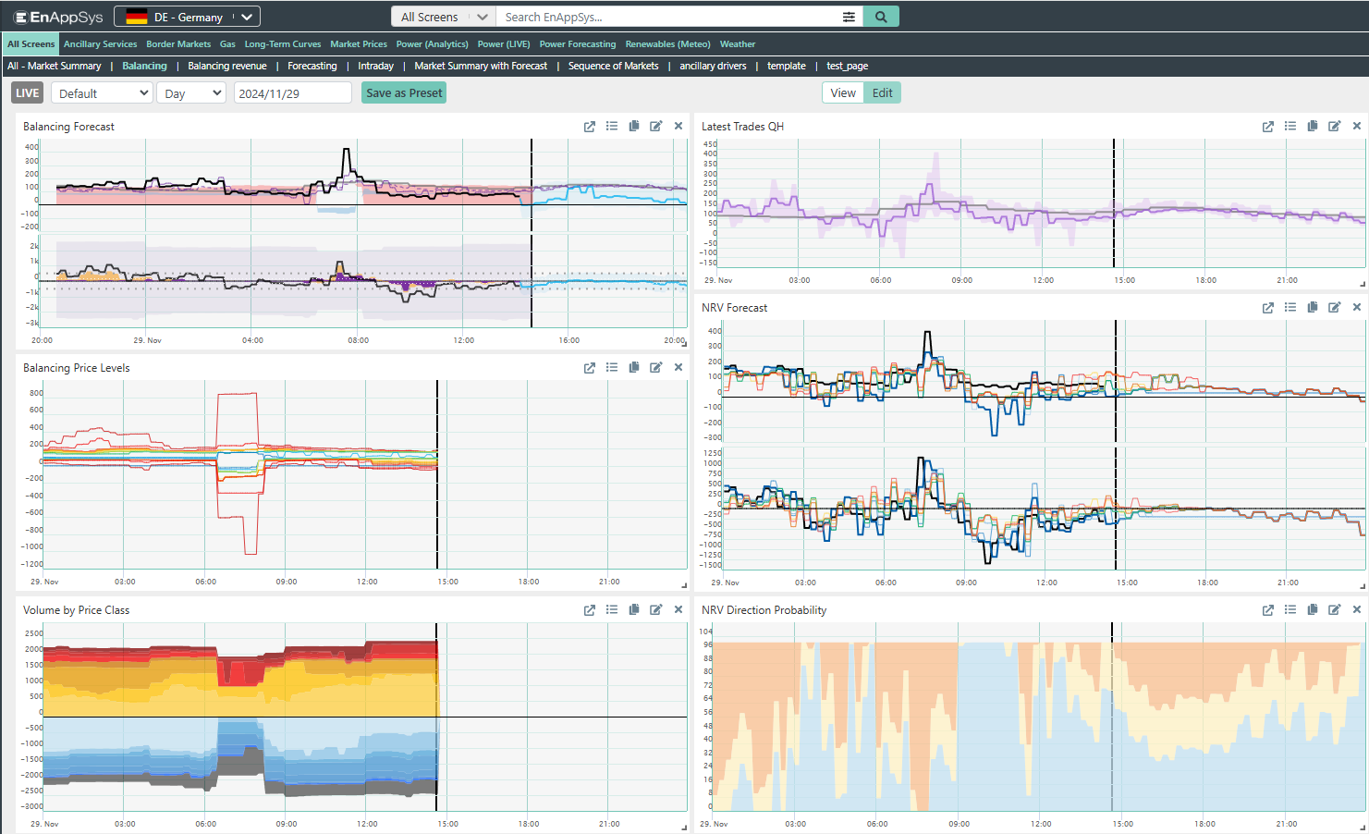
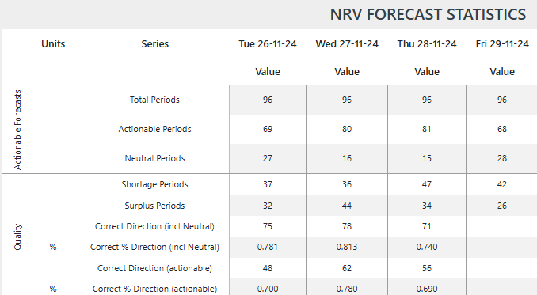
Forecasting the intraday market
We have recently launched our German balancing volume forecast.
This forecast combines fundamental modelling and machine learning to identify shortage or surplus in the intraday market.
This allows for identifying the optimal time to rebalance your portfolio. As the model retains the historic forecasts, you can monitor the trends as well.
Forecast vs actual
Trade Evolution
Forecast history
Market Depth
Market Depth
Forecast Direction

Slide 31
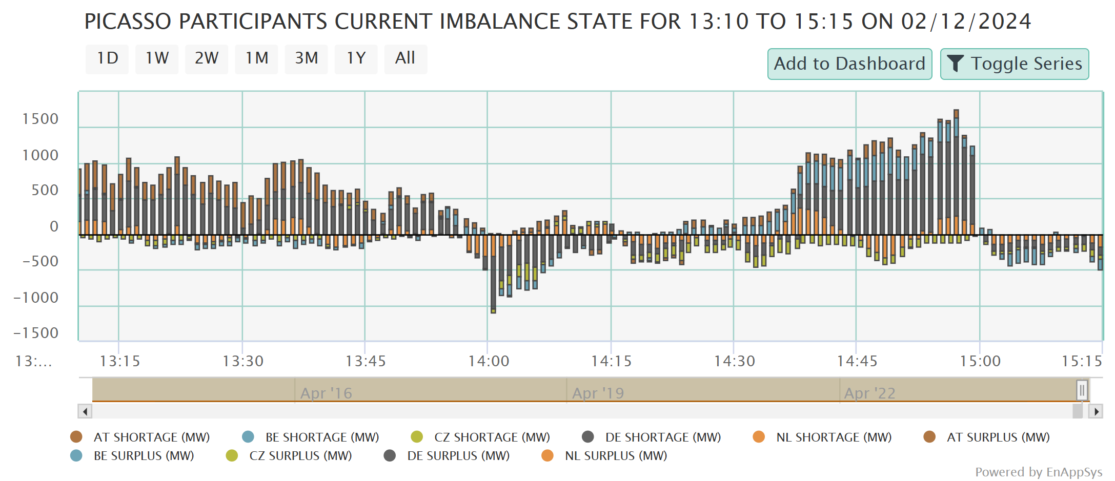
Looking across the border
As markets further integrate, cross-border information becomes more important.
Some markets have less delayed publication, which in combination with earlier data can give you an edge.
Dutch, Belgian, Danish data has much less delay than German data.

Slide 32
Conclusions
By looking at a sequence of markets, you can get a sense of volatility potential with some accuracy from 3 days ahead.
Closer to delivery, you can “crowd source” market insight, by looking at cleared prices for capacity prices, day ahead, and intraday auctions.
In real time, balancing market information, combined with real-time continuous trading data, let’s you see the market’s reaction to events.
By judging the market’s response and comparing it to the insights you have gathered, you decide what to do… PROACTIVELY
A live view of the most important indicators further helps you respond to changes as they happen.

Slide 33
Follow our latest developments on montel.energy
Follow the latest market news on montelnews.com
Free trials for Montel Analytics available here
Follow us on LinkedIn:
                Montel
                Montel Analytics
                Jean-Paul Harreman

