Slide 1
Navigating Price Extremes: Evaluating PV and Wind Revenues in Volatile Energy Markets
E-World Webinar, 11.02.2025, 14:00 – 14:30 PM
Josephine Steppat, Analyst at Montel Analytics
Notes:
Extrempreise als Chance
Beschleunigung der flexiblen 24/7 Energiewelt
Ausblick

Slide 2
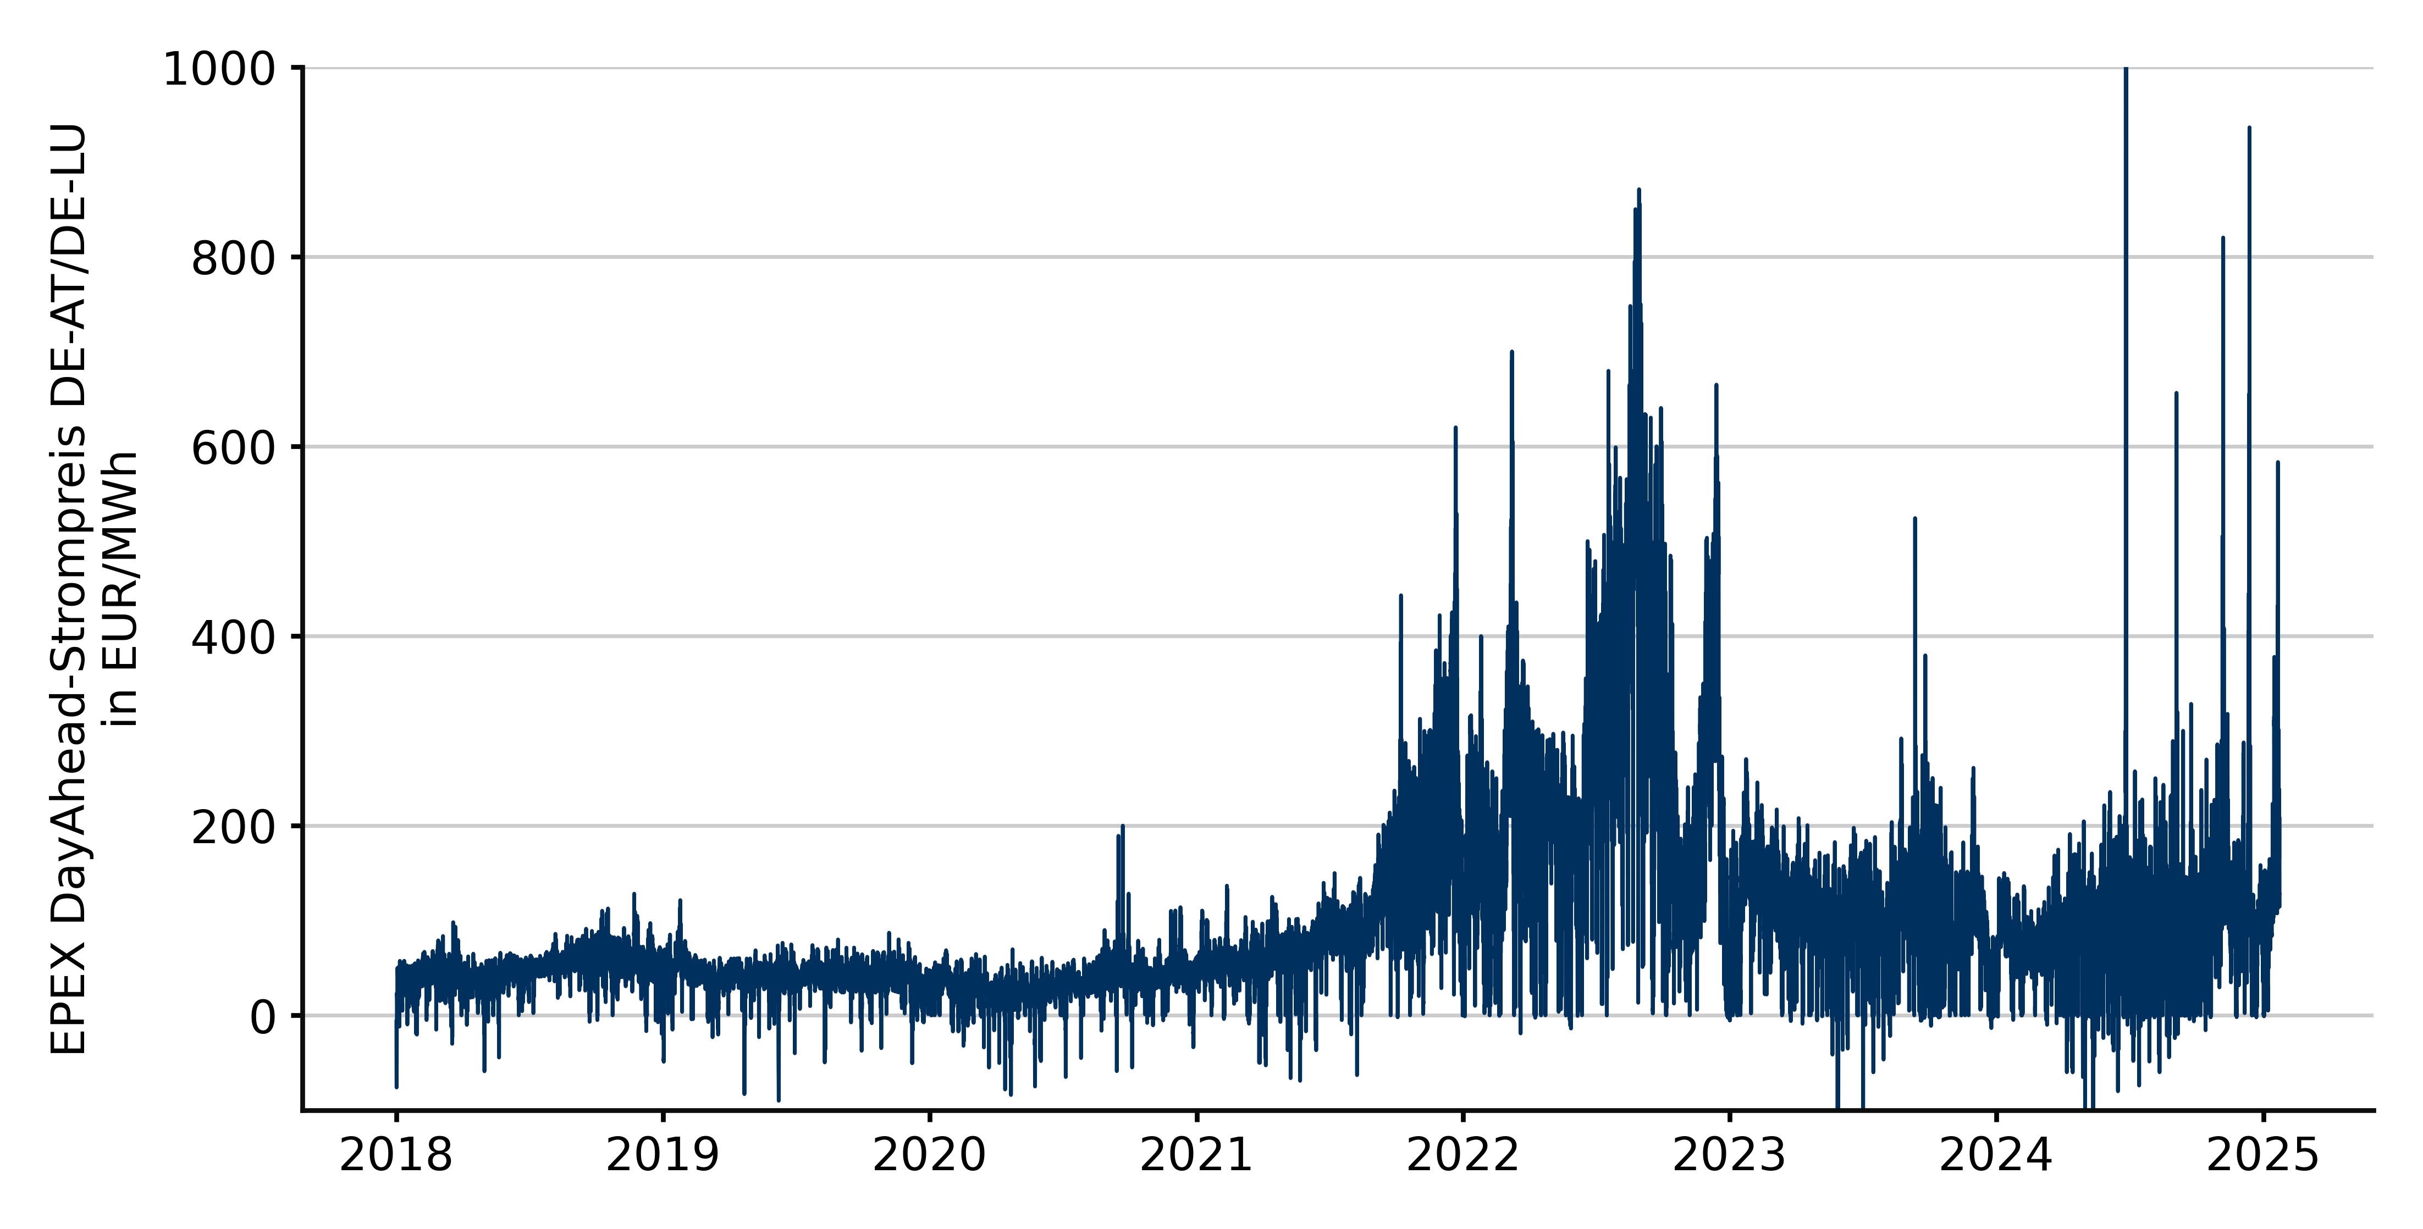
Historical development of hourly spot prices in Germany
Extreme price
Source: EPEX Spot
Notes:
In recent years, the volatility of electricity prices on the day-ahead market in Germany has increased significantly. Since 2023 in particular, extreme price peaks have been occurring more frequently, both in the form of very “high” and “negative” prices. But let's take a more detailed look on the German Day-Ahead market therefore:
Until the the end of 2021, the overall electricity price level was relatively low, and no significant volatility could be observed. Regarding extreme prices, very few "high" extreme prices were noted, but a relatively large number of "negative" extreme prices occurred.
During the energy price crisis, a significantly higher electricity price level was accompanied by a sharp increase in volatility. This period saw a noticeable rise in "high" extreme prices, driven by the high gas prices at the time. However, during hours when renewable energy set the market prices, the price level dropped significantly but "negative" prices were rare in this phase.
From 2023 onwards, the general price level declined again to a lower range compared to the previous phase. Nevertheless, it remained significantly above the pre-crisis level and also exhibited much higher volatility of the electricity prices. Since then, we have observed a considerable number of both "high" and "negative" electricity prices. Notably, many "extreme events" in this period have resulted in exceptionally high prices.

Slide 3



Extreme price
Examples of events with high volatility
2 July 2023 (solar surplus): -500 EUR/MWh on the DA market
26 June 2024 (decoupling of the markets): +2326 EUR/MWh on the DA market
06 December 2024 (“Dunkelflaute”): +805,08 EUR/MWh on the DA market
Notes:
🔴 29. August 2022 – The highest day-ahead wholesale electricity price during the energy price crisis occurred on Monday, 29 August 2022 between 7 p.m. and 8 p.m. with 871.00 EUR/MWh. In this hour, electricity consumption of around 56.0 GWh met a low feed-in from renewables (around 11.6 GWh) and a high feed-in from conventional sources (around 43.2 GWh). The high fuel costs - especially the price of gas - then led to the high prices on the market in this hour.
🌞 2. July 2023 – A significant incident occurred on 2 July 2023, when the day-ahead price fell to -500 EUR/MWh. This was caused by a combination of high renewable energy generation, particularly on a sunny and windy day, low electricity demand due to the weekend and moderate temperatures and the operation of inflexible conventional power plants that continued to produce despite negative prices. These factors led to an oversupply and therefore to this negative prices. ⚠️ 26. June 2024 –On 26 June 2024, there was a technical failure on the EPEX Spot electricity exchange, which led to a partial decoupling of the European electricity market. As a result, the price on the German day-ahead market rose to up to 2,325.83 EUR/MWh between 6 and 7 a.m. This extraordinary price spike was due to the limited market integration and limited supply. This extreme price was many times higher than the highest price during the energy price crisis.
06. December 2024 - On 6 November 2024, the day-ahead electricity price in Germany reached 805.08 EUR/MWh in the hour between 6 and 7 in the evening. The reason for this was the so-called ‘Dunkelflaute”- a weather situation with low solar radiation and weak wind. As a result, electricity generation from renewable energies was greatly reduced. In order to ensure security of supply, fossil-fuelled power plants had to be used to a greater extent, which led to an increase in electricity prices.

Slide 4
Development of negative prices on the day-ahead spot market
Extreme price
Number of negative prices
Average neagtive price in EUR/MWh
Minimal negative price in EUR/MWh
Source: EPEX Spot, own calculation
Notes:
In general: Negative electricity prices occur when the supply of electricity exceeds demand, often due to high feed-ins from renewable energies coupled with low demand for electricity.
The number of negative electricity prices rose until the energy crisis. The reason for the particularly high number of negative electricity prices in 2020 was a reduction in demand due to the coronavirus, while at the same time a high level of renewable energy feed-in prevailed on the market. As a result, 2020 was the record year for negative electricity prices up to that point.
In 2021, the number of negative hours was already significantly lower than in 2020, as 2021 was a poor year for RE yields and the supply of electricity was therefore somewhat reduced. From the second half of the year, electricity prices also increased due to rising gas prices.
In 2022, the number fell drastically once again, as electricity prices were high overall due to the gas price crisis and Russia's war of aggression against Ukraine.
2023 reversed the trend of falling negative prices again and even had more negative hours than 2020 - a full 3 hours. Of the 301 hours with negative hours, around 132 hours were in the period from May to August 2023, i.e. in the summer months in particular. This was also due to the decline in demand for electricity caused by the economic situation and a relatively high feed-in volume from renewable energies.
What we can also see, however, is that on an annual average the negative prices were rather ‘lower’ and did not ‘exceed’ -100, €/Mwh.

Slide 5
Zoom in 2024
Extreme price
2024 in numbers:
457 hours with negative prices
62 hours with prices equal to zero
‘Distribution: 320 hours between “0” and “-10” EUR/MWh, 132 hours between “-10 “and “-100” EUR/MWh, 5 hours above “-100” EUR/MWh
‘Seasonality":
343 of the hours occur between April and August
Most of the hours occurring between 10 am - 2 pm
Negative hours occur as ‘blocks’
Extreme events:
‘-135.45": 12.05.24 at 11 am, in a block of 9 hours with negative prices, high solar generation & low load
‘-120.07": 01.05.2024 at 1 pm, in a block of 8 hours with negative prices
‘-80.01": 15.06.24 at 12 noon, in a block of 10 hours with negative prices
Source: EPEX Spot, own calculation
Notes:
In 2024, a total of 457 hours with negative electricity prices were observed on the German day-ahead market. This is a significant increase compared to 2023 as we see. Looking at the months in which the most negative hours occurred, the summer months can be clearly identified. 343 of the hours with negative prices were in the months between April and August. In addition, most of the negative hours were between 12 am and 2 pm (around 293). We will look at this on the next slid in more detail.
This leads to the conclusion that the high generation from solar energy led to these ‘negative’ prices in 2024 since most of the solar production coming into the market at the specific hours and lead to the fact that the supply of electricity is bigger than the demand.
This is an interesting development, as historically negative prices have tended to occur in the winter months at night and were therefore more likely to be caused by high wind generation. In addition, negative hours in 2024 occurred as “blocks of negative prices”, i.e. several consecutive hours had a negative price and not that the negative hours occure as a single one.
Beside the negative prices there also a big amount of hours wich are not negative but zero, which is also interesting for the future revenue evaluation of PV and Wind assets. The lowest negative price in 2024 for Germany was ‘-135.45’ EUR/MWh On 12 May 2024 at 11 a.m. This was due to high generation from solar energy coupled with low electricity demand, which resulted in a block of 9 negative hours in a row.
However, most of the negative prices, totalling 320, were in a range of 0 to -10 EUR/MWh. 132 hours between -10 and -100 EUR/MWh and “only” 5 hours above -100 EUR/MWh. This distribution of the ‘height’ of the negative prices corresponds to the historical pattern as we seen in the slide before.

Slide 6
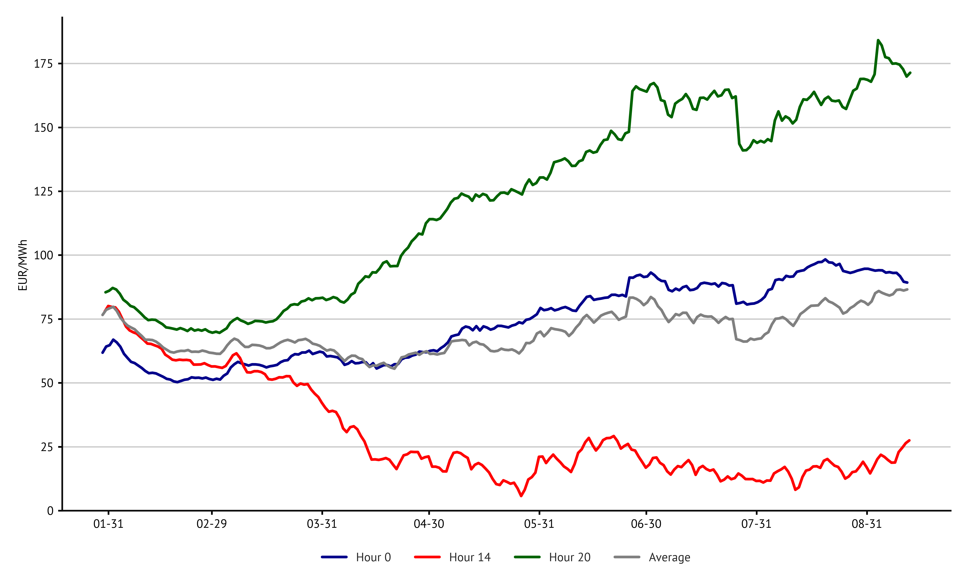
Price development - another perspective
Extreme price
Spot market prices for selected hours of the day
For 2024
Simple Moving Average
Spread between PV-peak and load-peak grows
Notes:
If we now look again at the average price level for different hours of the day up to August 2024, we can also see here that the midday hours in particular - here at 2 p.m. - are significantly lower than in the evening or night hours and also significantly lower than the average price across all hours. This is particularly difficult for the income from PV systems because the main generation takes place during these hours. But have a more detail look at the interaction between negeative prices and the amount of generation.

Slide 7
Influence of „negative“ prices on PV and Wind revenues in Germany for 2024
Impact on revenue
PV generation and number of negative prices
Wind generation and number of negative prices
Source: Energy Charts, EPEX Spot
Notes:
What we see here is on the left in yellow the generated net electrivity in the different months in 2024 for Germany and in green the distribution of negative hours for the same months in 2024. on the right we see the whole thing for onshore wind.
What we can clearly see is that the distribution of the number of negative hours optically correlates very well with the amount of generation from solar. This can lead to the conclusion that the increased feed-in from solar has led to the negative hours. However, it also illustrates that solar plant operators will most likely often have sold their electricity at negative electricity prices and shows the problem that these operators had no income for a large proportion of their electricity and may even have had to pay extra for this. This naturally leads many market participants to worry that their plants or projects will not generate the desired income.
However, the situation is different for wind, where we see the exact opposite: so the main generation was primarily in the winter months, when there were relatively less hours of low negative hours.
So let's take a look at how the profile value of the two technologies has developed in recent months.

Slide 8
Influence of „negative“ prices on PV and Wind revenues in Germany for 2024
Impact on revenue
Historical PV Profile Value (BPR)
Historical Onshore Wind Profile Value (BPR)
Source: ENTSO-E, Eurostat,, EPEX Spot
Notes:
The profile value - also shown here as the base parity ratio - is shown here on the left for solar and on the right for wind.
In this case, the base parity ratio describes the value of the renewable electricity compared to the base price in %. A higher BPR therefore means a higher profile value and a lower BPR means a lower profile value.
For solar, we tend to see a seasonality in the BPRs, which are higher in the winter months and lower in the summer months. However, this year we could see that the BPRs have fallen significantly more in summer than was the case in previous years (i.e. in 2022 and 2023). This makes it clear that the electricity from PV in 2024 was worth significantly less in summer than the base price. However, if we remember the previous slide, we can see that it was precisely in these months that generation was at its highest. So this also shows the problem with the plant operators’ revenues for their electricity.
With onshore wind, it is difficult to predict a general seasonality in the BPR. However, we can also see here that the profile value is constantly decreasing.
The increasing supply of electricity from renewable energies therefore leads to the plant operators themselves cannibalising their revenues and leads to an imbalance between supply and demand on the market, which then leads to the many negative prices. In order to counter negative prices, there is a regulation specifically in Germany with § 51 of the EEG, which should lead to less electricity from subsidised renewable energy plants feed in into the market. To this end, a further tightening was introduced at the end of January this year. This regulation naturally has a major impact on the development of the number of renewable hours.
However, we don't want to go into this in more detail in this webinar because we want to look at how the balance between supply and demand can be restored with the help of flexibility options.
However, I can recommend a blog post by my colleague Matthuis Brinkhaus, who has written an interesting article about this on the Montel blog.

Slide 9
Flexibility
Flexibility options
Fluctuating renewable generation
Hydro power & biogas
Hydrogen/gas turbines
Inflexible demand
Dispatchable generation
Electrolyzer
Transmission grids & interconnectors
E-mobility
Flexibility options
Flexible demand
Grids
Heat pumps
Distribution grids
other
Storage systems
E-mobility (vehicle2grid)
Home BESS
Large-scale BESS
Notes:
The increase in renewable energies for electricity production in the system increases the need for flexibility options, both on the generation and also on the demand side. On of the key flexibility options are Battery storage, where I mean both ‘stand-alone’ and ‘co-location’ battery storages. Standalone’ energy storage systems can use the price predictions on the electricity marekt as a business case by storing electricity during hours with negative (or low) prices and withdrawing it during times when prices are ‘high’. In this way, electricity can be stored during times of surplus electricity and added during times of low electricity production or high electricity demand. This stabilises the system in both situations and can counteract extreme prices, especially negative ones.
With Colocation’ battery storage, I mean the combination of an RE system and a battery storage system the generation profile of the systems can “flexibilise” and also improve the profile value. This is especially interesting for Solar. This “Energy shifting” allows electricity to be shifted to hours with a “supply shortage” and can also prevent additional electricity being fed in during hours with a “supply surplus”.
Also The electricity grids and dispatchable generation units, such as pumped storage power plants, also represent another flexibility option and help to stabilise the prices. In particular, the well-functioning electricity trading with neighbouring European countries significantly stabilises the price of the electricity. I think this also became clear to everyone on 26 June 2024, when a technical error on the exchange occur and this was the due to the fact that this cross-border trading did not work.
Another important flexibility option is the flexible electricity demand, which includes electrolysers, heatpumps and emobility. These electricity consumers can therefore be used as ‘artificial electricity consumers’ during certain hours, e.g. to consume at times with a high level of generation from renewable energies the electricity (and thus prevent ‘negative’ extreme prices). In contrast to battery storage, however, only the demand is flexibilised here and not the supply.

Slide 10
Flexibility
Expected development of flexibility options
Source: Power Price Scenario from Montel
Notes:
ELY
Bureaucracy too difficult
PPAs difficult to find
Additionality and simultaneous production & consumption in question
Heatpump:
Governmental goal:
500,000 installations each year from 2024 onwards
Assumption: 10 kW on average
New installations achieved
2023: 356,000
H1-2024: 90,000
2024 (expected): 200,000
E mOb:
Germany as a late mover
No clear incentives, no passionate strategy, no effective support
Attempt to protect combustion engines
cars and charging stations: chicken and egg
Outlook:
Massive charging/discharging capacity
Temporary available, mobile
Battery:
The difficulty with BESS is not so much getting current figures (we have a good source for DE with battery-charts.de), but rather estimating how much of this capacity is actually available to the DA market. We are currently assuming (perhaps a little too conservatively) that it is only 25 % of the total capacity and output of large storage systems.

Slide 11
Flexibility
Flexibility options
Fluctuating renewable generation
Hydro power & biogas
Hydrogen/gas turbines
Inflexible demand
Dispatchable generation
Electrolyzer
Transmission grids & interconnectors
E-mobility
Flexibility options
Flexible demand
Grids
Heat pumps
Distribution grids
other
Storage systems
E-mobility (vehicle2grid)
Home BESS
Large-scale BESS
Notes:
But let's take a look at what happens to the price of electricity if we change something in the flexible demand for electricity.

Slide 12
Flexibility
Sensitivity:
What would happen to the power price, if flexible demand was…
a. 50% lower
Next 10 years: power price to rise significantly
After 2035: no big impact on the power price
The spot market price would be reduced by 5 to 10 %
b. 50% higher
Source: Power Price Scenarios from Montel
Central
Notes:
We have calculated a small sensitivity using our electricity price scenarios and the central scenario for our Q3 2024 update and looked at what would happen to the power price if we were to make our electricity demand more flexible or reduce less flexible than we assume in the scneario.
50% lower here means that we have less flexible electricity demand but more fixed or inflexible electricity demand to compensate for this less flexible demand. So we have changed the composition of the electricity demand here.
50% higher means that we assume more flexible electricity demand and less fix electricity demand.
With less flexible electricity demand, electricity prices would rise significantly in the next 10 years and then have no big impact on the power price from 2035. So With less flexible electricity demand, the electricity price would initially rise because more generation from expensive generation or imports would be needed in the hours when there is not enough RE generation available on the market and the (more fixed) electricity demand would then have to be covered.
In the long term, however, it also means that with low-flex sensitivity less power shifted to low-price hours, so to the PV peak hours so that the price decrease in this hours and on average the price level not change compared to our standard scenario.
With a higher flexible demand for electricity, the spot market price would be reduced by 5 to 10 %, because the ‘positive’ extreme events can now be prevented, as we have less fixed demand and the flexible consumers will not demand electricity in these hours. On the other hand, there are the hours, especially in summer, when the flexible electricity consumers shift more power to low-price hours (PV peak hours) and thus increase the electricity price in these hours. Overall, the annual average electricity price decreases.
So if we want to prevent us better for the high electricity prices the flexible demand can contriubute here good. To takel against negative prices the flexible Demands also helps by shifting more demand in hours with high generation especially in the the PV peak times.

Slide 13

Let‘s stay in contact!
Josephine Steppat
Analyst
Montel Analytics
josephine.steppat@montel.energy
+49 162 9295877

