Slide 1
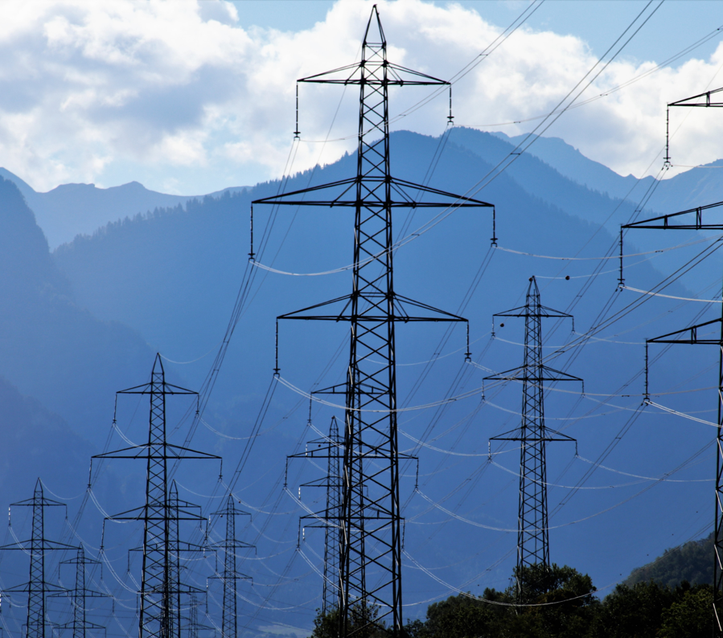
Price Forward Curves & Simulations - Introduction
Notes:
Maik
Hallo und willkommen
Ganz kurze vorstellung (Name und Titel)
Here we are with our second Webinar in the world of Risk Management tools. Today we have a specific look on the spot and future markets of France and UK and will go one step further to show you the goals and use cases of simulations.
Daniel
Because of this huge number of attendees, we have planned extra time at the end to answer questions. So we would appreciate if everyone with a question, could write them in the question-section
Our Managing Director Marc Hasenbeck will be also on board for giving a deep dive into Risk Figures and the creation of Simulations and our Senior Analyst Felix will be in the background for collecting questions, which we will answer at the end of the presentation

Slide 2
AGENDA
Overview: spot and futures market
PFC
  Introduction to PFCs
  PFC Examples
  Applying a PFC to basic issues
Simulations
  Introduction to simulations
  Use case simulation

Slide 3
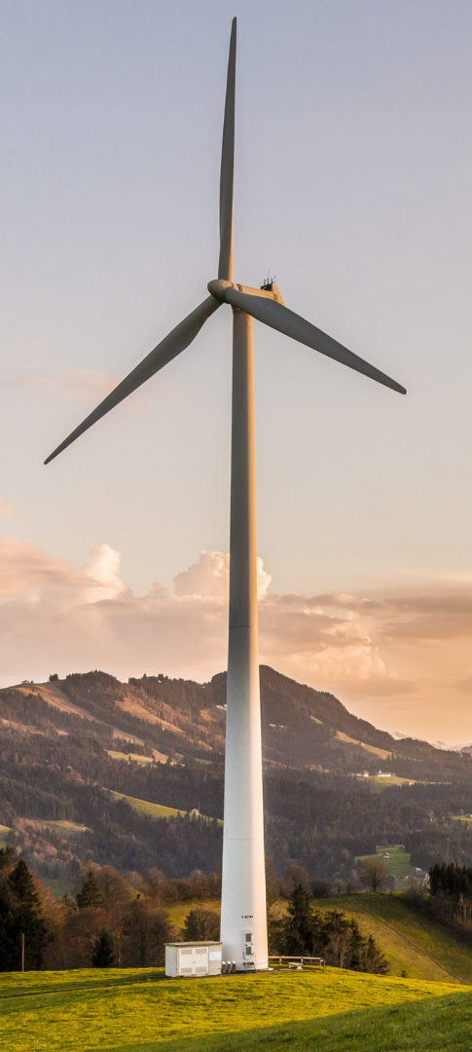
Overview: Spot and futures market
Consumption and supply
  Direct consumption after production and strongly fluctuating consumption curves of households and industry lead to strong volatility.
  Some markets has a dependency on temperature, partly driven by the higher rate of households that heat with electricity.
Global radiation and wind
  Feed-in of cheap, sustainable electricity (solar and wind) leads to strong downward price movement (cannibalization effect).
Other commodities
  Prices for gas, coal, oil and CO² certificates influence electricity prices and vice versa.
Technical circumstances
  The shift from expensive fossil-fueled power plants to low-cost renewable energies will have a lasting impact on pricing (merit order model).
  The shutdown/start of power plants has an impact on the wholesale price.
  Expansion of electricity storage systems and electrolyzers ensure lower volatility.
Market coupling
  European Markets are coupled to each other and therefore influence each other on the spot market level.
Notes:
Daniel
Lets have a look on influencing factors in the spot markets:
Please keep in mind, all of these factors can be highly different between the markets in there characteristics and in intensity
Examples:
consumption and supply
Direct consumption and fluctuating consumption curves of the households and industry causes high volatility
Some cuntries has a depency on temperature, partly driven by the higher rate of households heating with electricity in comparison to other countries.
global radiation and wind
Different strategies, governmental targets and physical restrictions lead to different shares of production for solar and wind
Some markets has a way bigger share on Solar/Wind then others with for example a biger focus on nuclear
other commodities
Different power mixes and slightly different Market prices of the other commodities influence the prices and vice versa
France mainly has Nuclear power witch is not dependent on other commodities and GB with mainly Gas wich is highly depedent on Gas-Prices
technical circumstances
One big driver for everchanging spot markets and again highly depended on historical and local factors + targets for development
Again: in FR an unexpected downtime of one nuclear plant can completely change anticipated spot market levels, while GB with more flexible and smaller Gas units can easier and cheaper react
Market coupling
Different connectors and transition capacities lead to different effects on coupled prices

Slide 4
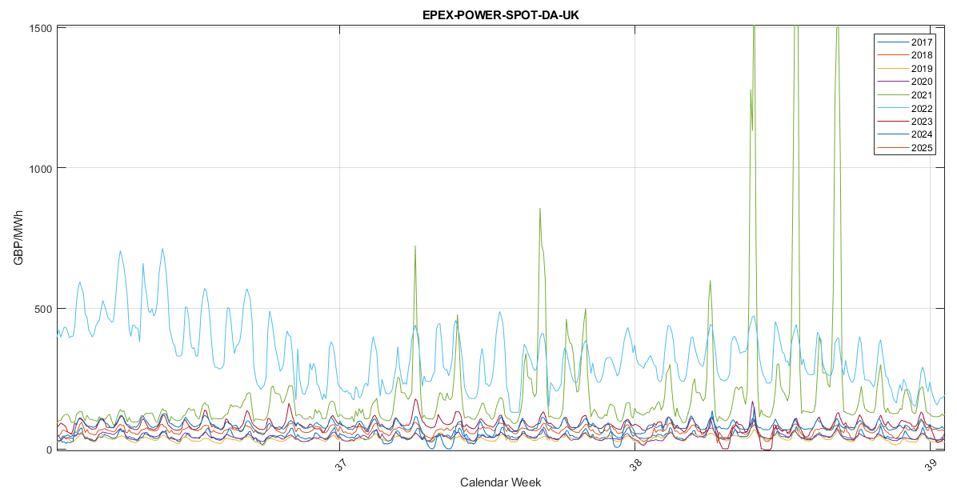
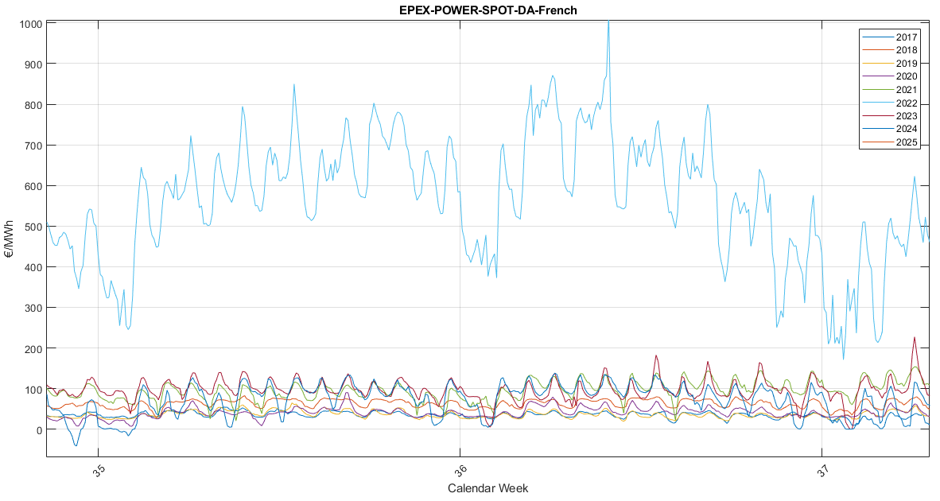
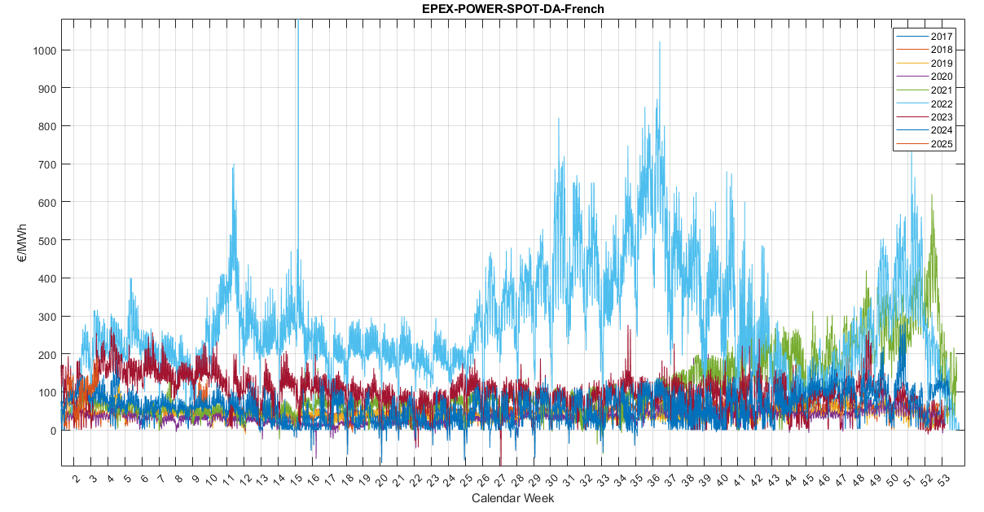
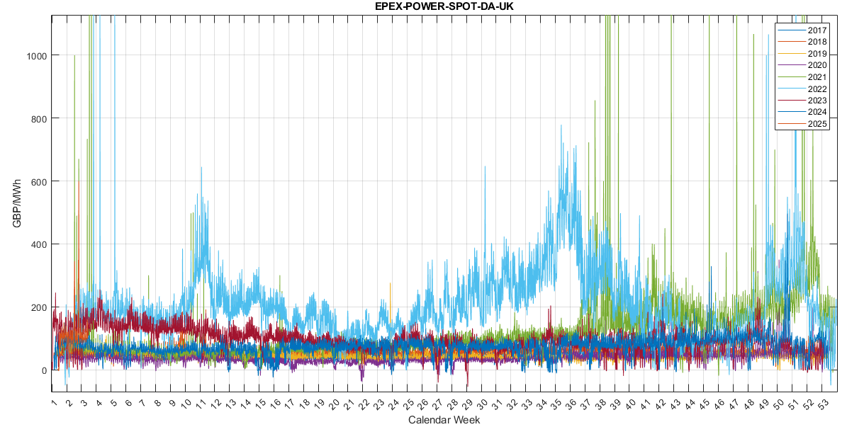
Overview: France’s & GB's spot / futures market
Notes:
Daniel
FL:
4 Bilder welche mit klick einzeln erscheinen:
1/3: FR/UK Spots von 2017 bis jetzt in den Jahren übereinander gelegt (nach Kalenderwochen, Montag KW2 liegt auf Montag KW2 etc.)
2/4: FR/UK Spots Zoom auf 3 Wochen
Different Base-Heights (War in Ukraine)
Changing pattern in week
Spikes in hours and days

Slide 5
Overview: Spot and futures market
What kind of product is a FUTURE?
  If you buy a futures contract, you will get a fixed price for power from the spot market over a specified time in a specific load profile in the future.
  You will get the same amount of power over the whole time.
  You will have to pay a fixed (average) price for this NOW.
Why buying a FUTURE?
  After buying there is no risk anymore concerning the spot prices for that delivery period of the futures contract.
    A Future is a kind of price insurance.
Remarks:
  Because the futures contract deals with spot delivery, the spot is called the “Underlying“ of the contract.
  The price is set by the market, which certainly takes an average of the individual expected prices for all hours.
  Different Exchanges offering Future products for the same markets.
    They generally have different concepts and offerings for these markets.
      e.g. how many years they cover, how many front products they have in each category, do they have base and peak as load profiles, etc.
    --> PFC's and simulations are always for a specific combination of Market and Exchange
Notes:
Daniel
FL
Why Buying
To reduce the risk!
Im Letzten Absatz bei: "Different Exchanges offering Future products for the same markets"
--> Remark that spot markets are also served by different exchanges, but here the market design/products are always the same

Slide 6
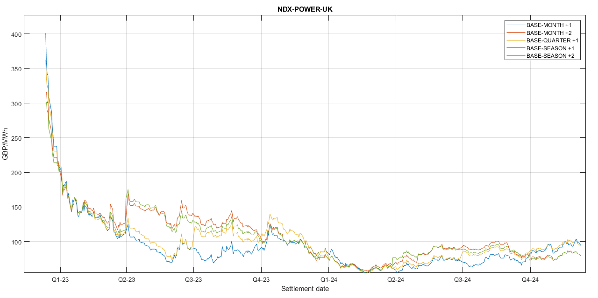
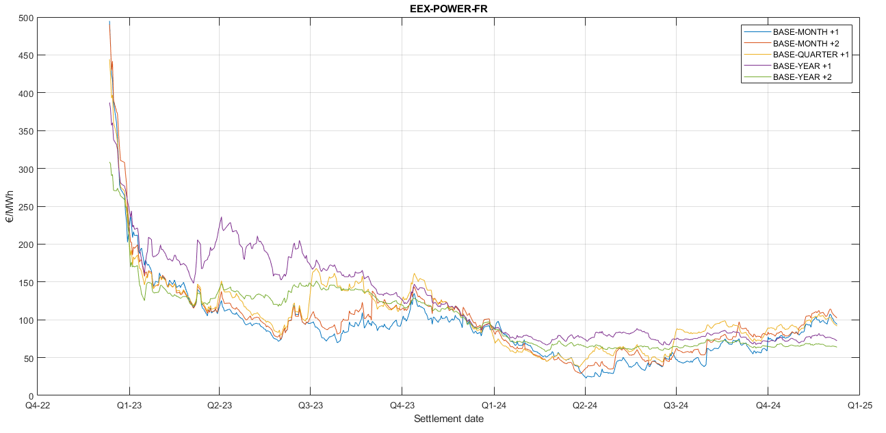
Overview: Spot and futures market
EEX FR
Deliveryperiods: Days, Weekends, Weeks, Months, Quarters and Year
Loadprofiles: Base, Peak
--> a lot of small products but no seasons and less Month products
NDX UK
Delivery periods: Months, Quarters and Seasons
Load profiles: Base, Peak
--> Missing "small products" like Days and Weeks + no Years but a lot of Month products
Notes:
Daniel
FL:
2 Bilder welche mit klick einzeln erscheinen:
1: FR Futures for different product categories (Front Month Base, Month + 1, …)
Box shows offerings from NDX (wichtig die Börse herauszustellen)
2: UK Futures for different product categories (Front Month Base, Month + 1, …)
Box shows offerings from EEX
--> sehr unterschiedliche Produktauswahl herausheben hier dran

Slide 7
Introduction to PFCs
MONTEL RISK
Definition:
A PFC is a transformation of actual futures prices for all delivery periods into one unique timeseries for several years (1-10 years).
which comes along in the same resolution as the underlying (spot market) and schedules
This “decodes” the average futures prices in the needed time resolution:
Power: Hourly (HPFC) / Quarterly (QPFC),
Gas: Daily (DPFC),
CO2: Daily (DPFC).
From the futures market, we only know the average price for the delivery period, but not the forward price for each individual hour. -> We need a PFC to value the schedule!
A PFC answers the following questions:
How much is my Outcome/Income/Portfolio of Power (or Gas) worth?
What does energy normally cost on a Monday afternoon in November based on historical price information?
How much risk is in my open positions (left/unhedged volumes)?
Which specific contract is most responsible for my current risk?
Notes:
Maik

Slide 8
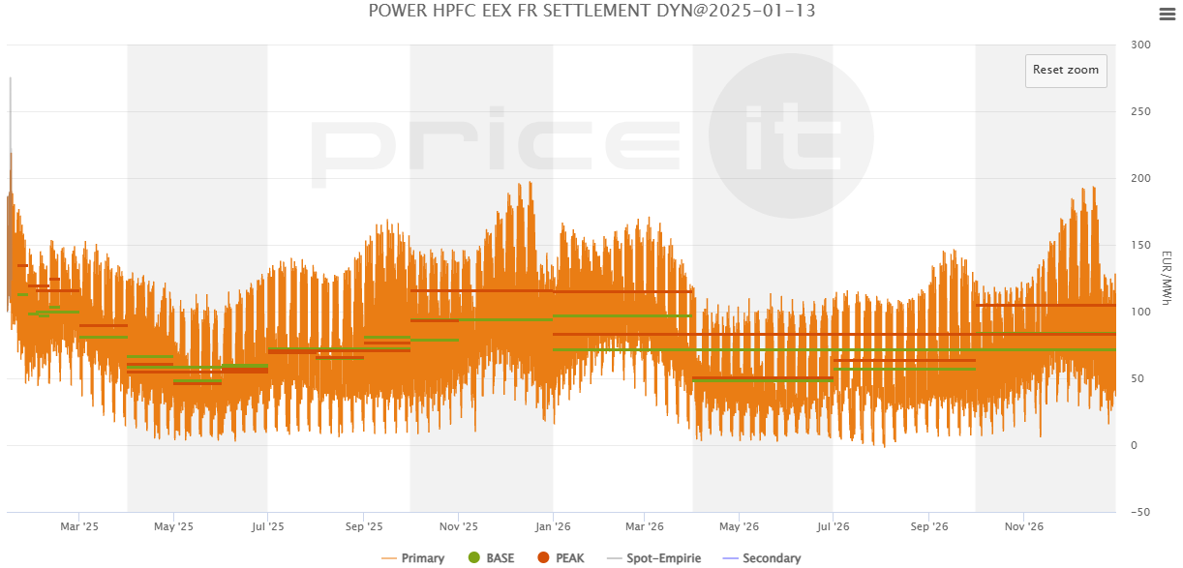
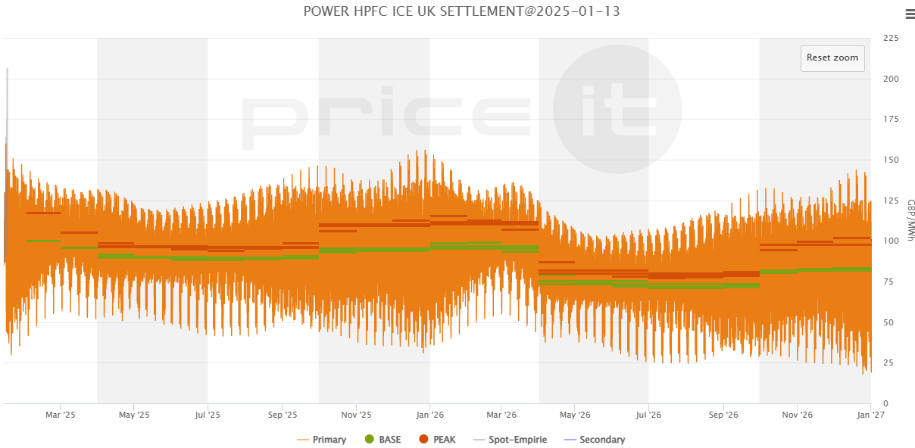
PFC – Examples
Notes:
Maik
FL
* 1 example for each market for trading date monday the 13th of January 2025 and the years of 2026/2027
Die Unterschiedlichen Futures zeigen und wie die PFC um diese Futures drum herum läuft (auf Konzept von Seite vorher eingehen)
Eingehen, dass man auch leicht unterschiede erkennt, aber auch zusammenhänge (Marktdesign grundlegend gleich, marktkopplung etc.)

Slide 9
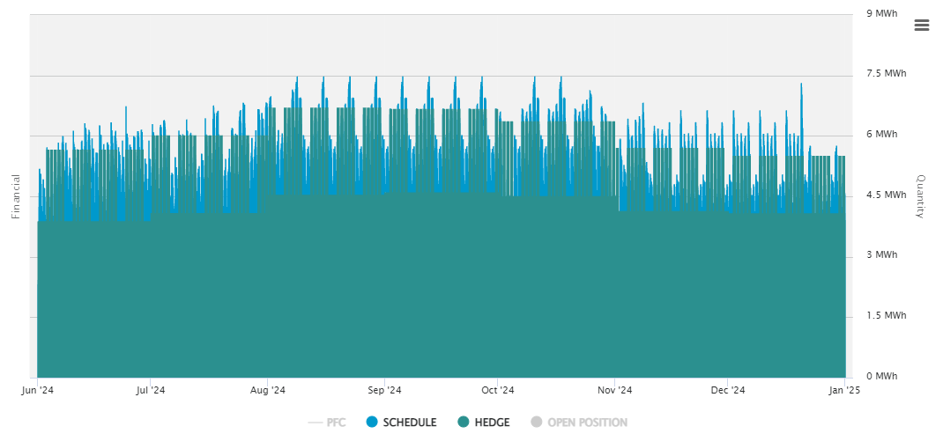
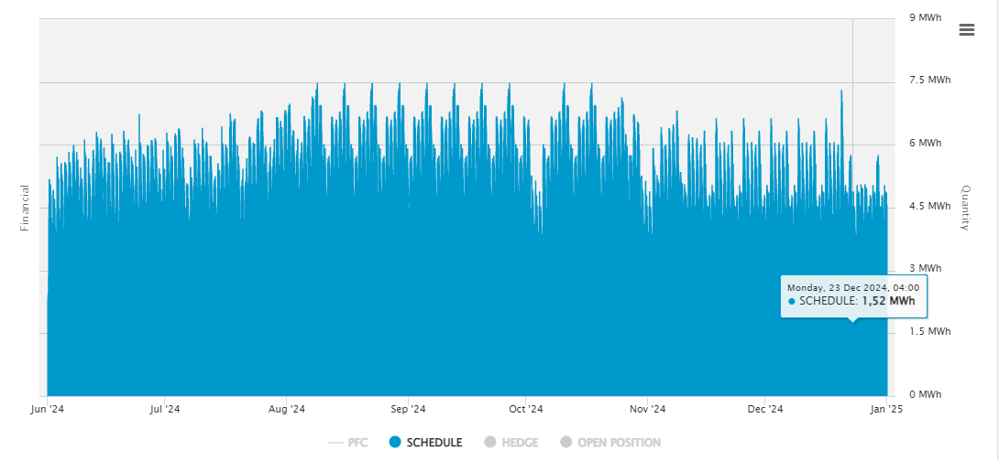
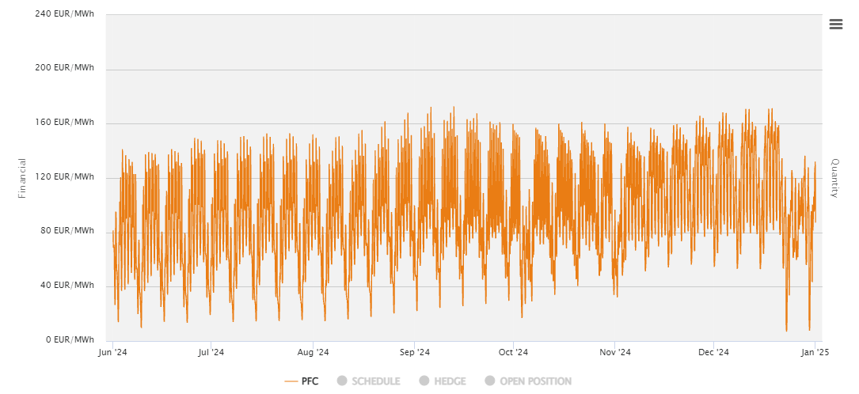
Applying a PFC to basic issues
Valuing an hourly load schedule
Every hour the customer wants a different amount of power!
Proposition: The utility company wants to win the customer while bearing as little risk as possible.
Two steps are necessary to continue:
    Finding a value for the schedule (price basis for customers & basis for hedging).
    Apply value-neutral hedging through procurement to achieve a margin though additional risk premia..
    →buy a certain number of futures contracts on the futures markets for an amount of money identical to the total value of the schedule
From the futures market one only knows the average price for the delivery period , but…
…not the futures price for every single hour. -> Need for a PFC to value the schedule!
Now the utility company can price and close the deal with the customer.
    Note: price is known; strategy to avoid risk is implemented
Notes:
Maik

Slide 10
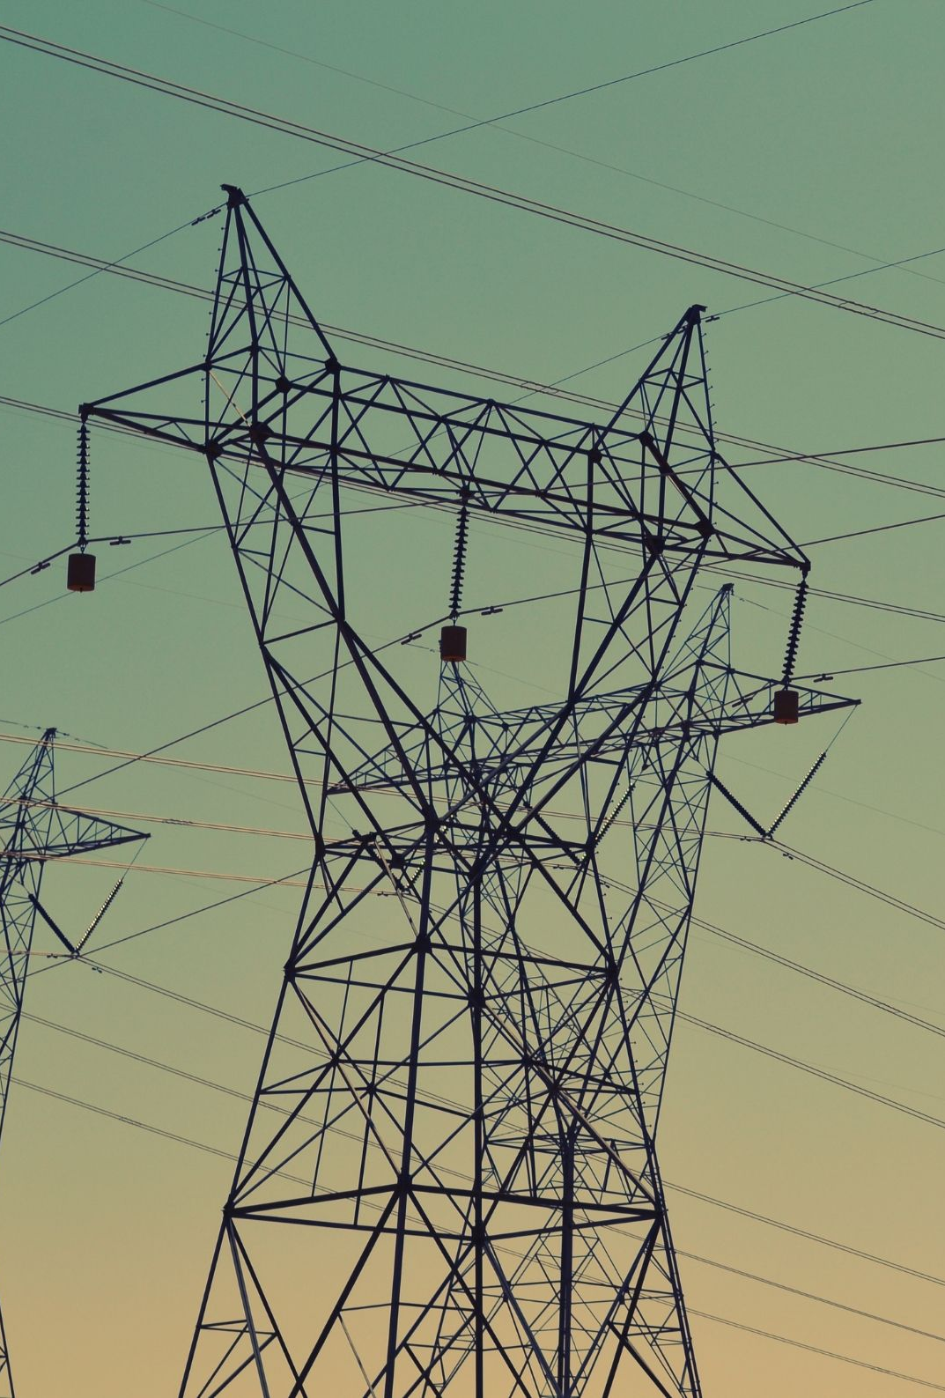
Introduction to simulations
MONTEL RISK
The spot markets are highly volatile and are determined by unpredictable factors such as weather events (sun, wind, water) and spontaneous actions (plant failure, wars, accidents).
Deviations from HPFC often cause critical cashflows.
How can I handle unpredictable shocks & spikes in spot markets for planning, pricing and risk management?
A PFC is the average expectation for spot patterns and is linked to the current futures market.
Notes:
Daniel
FL:
Nochmal Spotbild rein --> Spikes, krass volaitilität und Events (Wind/Solar, Kraftwerksausfälle, Kriege die ich nicht für in 1-10 Jahren vorhersagen kann)
What does the PFC: A PFC provides us with an average expectation of the future using the current future level
How can I include in my valuations etc. How can I bring in what the spot market also has (spikes etc., see above)?
--> Wie kann ich in meinen Bewertungen etc. Das reinbringen was der Spotmarkt auch hat (Spikes etc, siehe oben)
Was macht nochmal PFC? --> MITTLERE Erwartung über die Zukunft mit Hilfe des aktuellen Futures Levels

Slide 11
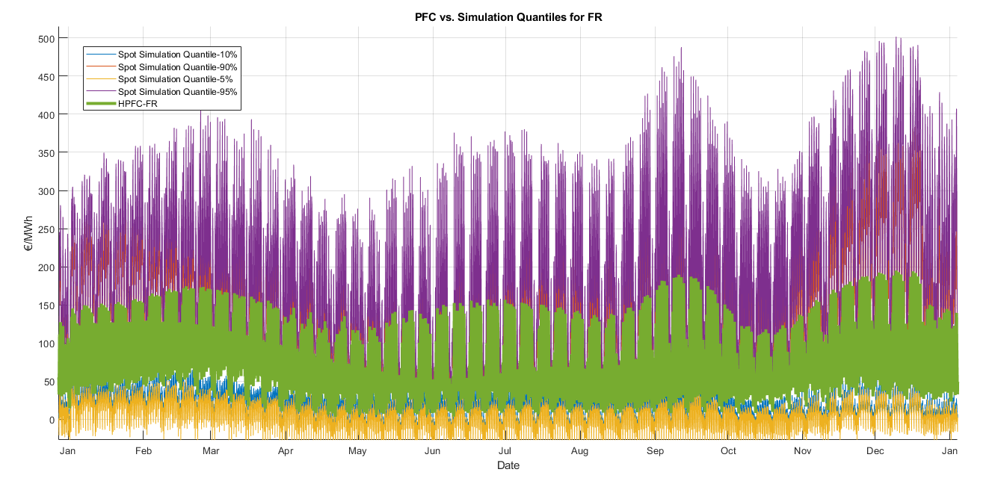
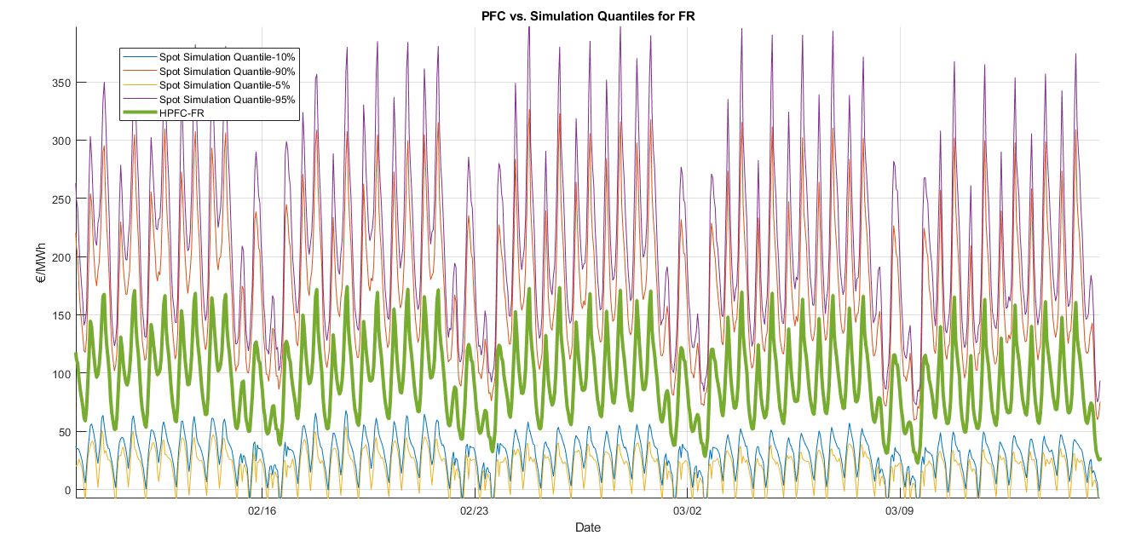
Let's get the PFC in motion with simulations!
Notes:
Maik
Danach: Marc spricht weiter und stellt sich vor

Slide 12
Use Case: Price Simulations
Description:
As a power plant owner, I would like to overhaul or expand my facilities.
Questions:
  How do I value different extension stages?
  How can I take different price trends in my valuation into account?
Advantages for customers by using Price Simulations by price[it]:
Customized product regarding parameters, commodities, delivery and customers market assumptions
The simulations are consistent to the PFC, but extend them by 5.000 to 10.000 additional market scenarios
Notes:
Maik:

Slide 13
Use Case: Price Simulations
Description:
As a power plant operator, I am responsible for dispatching a huge storage system (gas storage, heat storage, pumped storage)
Questions:
What is the value of the different storage levels for now and in the future?
How can I take price uncertainty into account?
Advantages for customers by using Price Simulations by Montel Risk:
Asset Valuation: Based on price simulations we can provide customized decision support on specific dispatching tasks
The simulations are consistent to the PFC, but extend them by 5.000 to 10.000 additional market scenarios
Notes:
Daniel

Slide 14
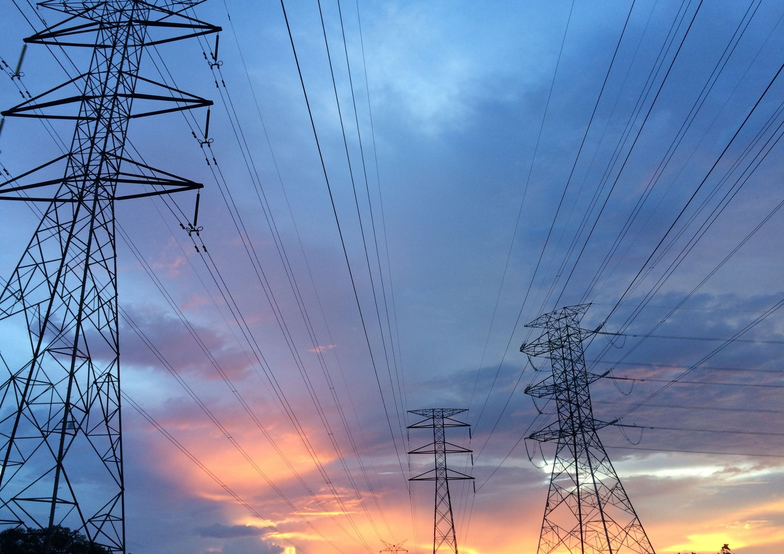
Maik Bräuer
Sales | Projects
Daniel Gehardt
Sales Manager
Mail: price-it.sales@montel.energy
Thank you for your attention
Notes:
Daniel
Thank you all for participating in this webinar.
We will send you the presentation and all questions + answers in a follow-up mail.
If there are any further questions or if you are interested in a personal meeting, a free trial of a PFCs. Or if you are interested in a deeper insight into the topic.
Please feel free to write to us at the email address provided or follow the links in the follow-up mail

