Slide 1
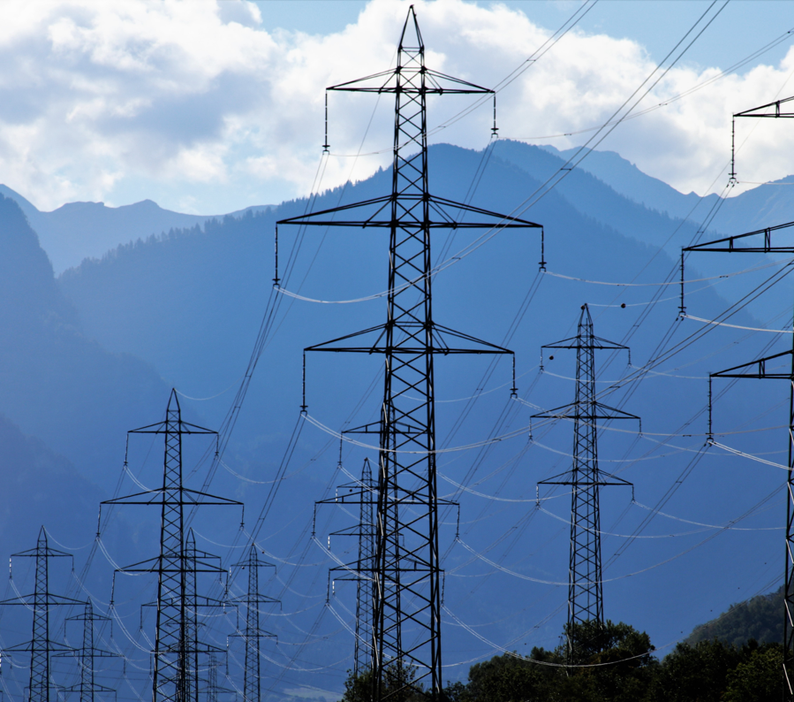
Introduction to Price Forward Curves
Notes:
Maik
Hallo und willkommen
Ganz kurze vorstellung (Name und Titel)
Daniel
At first a big shout out to all of you, we are overwhelmed by the tremendous number of registrations for this webinar, thank you. But because of this huge number of participants, we can‘t answer all questions in the end as planned. So we would appreciate if everyone with a question, could write them in the question-section
Our colleague Felix, which is also in this webinar, will answer them immediately and the non answered questions will be answered afterwards and sent to everyone in an separate mail
( At the end we can pick up some of them)

Slide 2
Timeline
Introduction to Montel Risk
What is a Price Forward Curve?
Introduction to the Markets
How is a PFC calculated?
Use Cases
Methodologies
Characteristics
FAQ
Notes:
Maik
Ok lets start and go through our Agenda
This is the first Webinar of us (Montel Risk) and we wanted to start from the bottom on a very low level
But we can go deeper in future and offer more Webinars to specific PFC topics, so at the End you can write you proposals in the question section

Slide 3

Who we are
Montel Risk (former Price[it]) is an IT company founded in 2006 from a university spin-off that deals with pricing mechanisms in the field of energy trading transactions under risk.
We are located in Halle (Saale) in Germany and belong to the Montel Group since 2017
Notes:
Maik

Slide 4
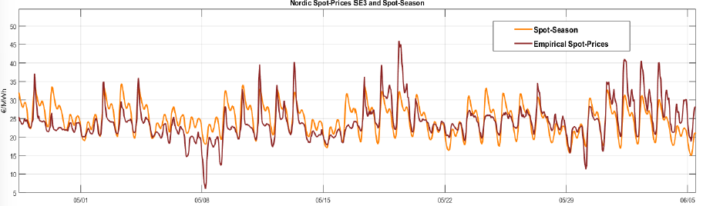
What is a Price Forward Curve?
First: The Spotmarket…
… is a market to receive power (or Gas) -> Every delivered unit is bought at the spot market in the end!
Note 1: Power can be bought only 1 Day Ahead before delivery -> Spot Prices are embedding a lot of price risk
Note 2: Spot prices embed a certain structure (e.g. weekends and night hours are cheaper than working hours)
Notes:
Maik

Slide 5
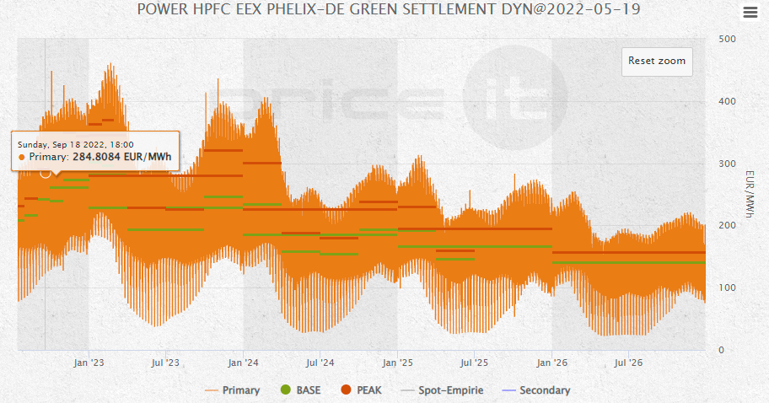
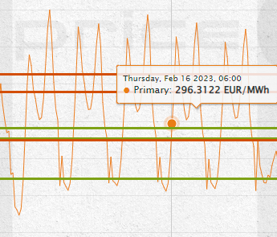
What is a Price Forward Curve?
Second: The Futures Market… … enables you to eliminate these risks!
What kind of product is a FUTURES? -> If you buy a futures contract …
… you will get power from the spot market over a specified time
in the future (e.g. Q2)
… you will get the same amount of power over the whole time
(e.g. 1 MW, flat for a whole year)
… you will have to pay a fixed (average) price for this NOW
There is no risk anymore concerning the spot prices for the delivery period of the futures contract
-> A Future is a kind of price insurance
Remarks:
Because the futures contract deals with spot delivery, the spot is called the “Underlying“ of the contract
The price is given by the market who surely takes an average over the single expected prices for all hours
Notes:
Maik

Slide 6
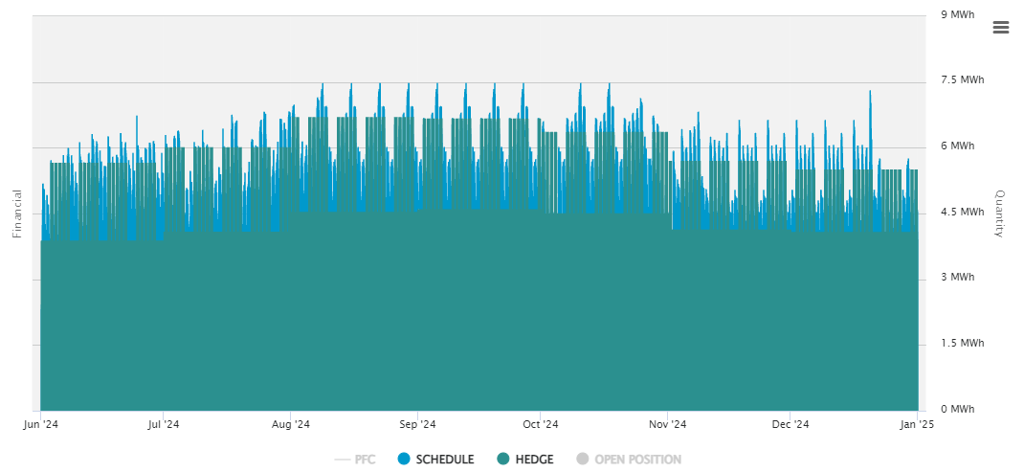
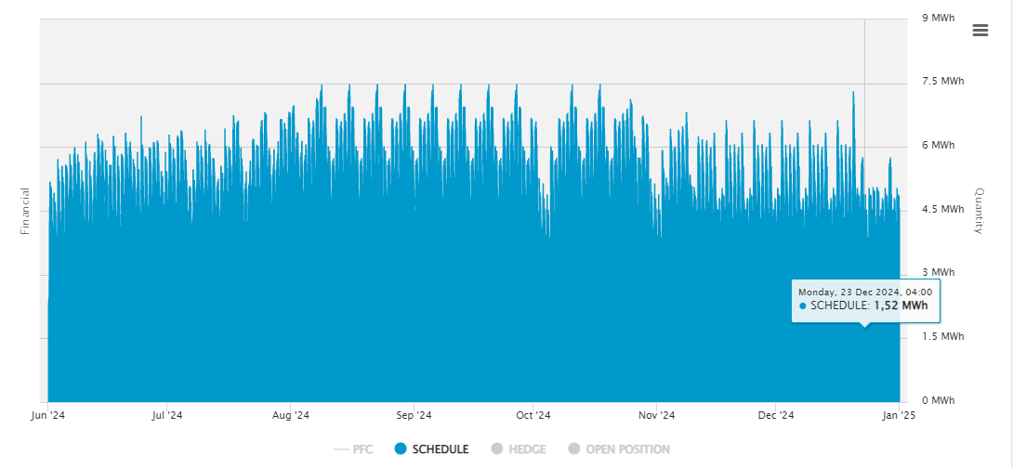
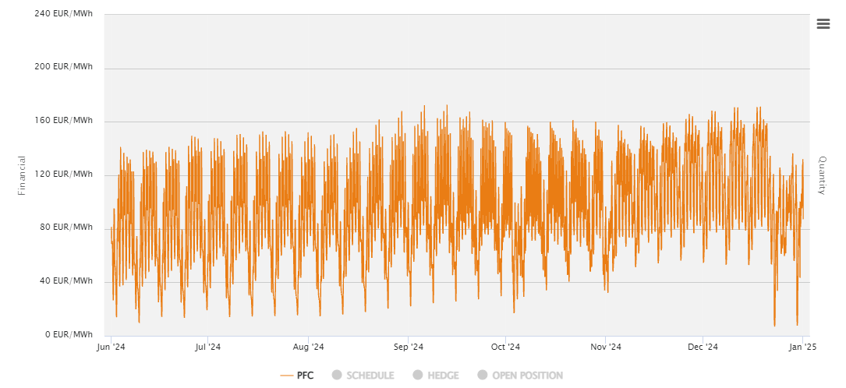
Third: The typical Power Utility…
… sells power (or Gas) to its customers. The customers come along with a schedule in hourly resolution like this one:
Every hour the customer wants a different amount of power!
Proposition: utility wants to get the customer while bear as less risk as possible
Two steps are necessary to continue
One needs a value of the schedule (price basis for customer & basis for hedging)
apply value neutral hedging by the procurement to generate margin → buy at the futures markets a certain number of futures contracts for an amount of money which is identical with the overall value of the schedule
From the futures market they only knows the average price for the delivery period , but…
…not the futures price for every single hour -> They need a PFC to value the schedule!
Now the utility can price and close the deal with the customer
Note: price is known; strategy to avoid risk is implemented
Notes:
Maik
Lets come to a typical use case
A PFC is also a weighting of my most important peak hours

Slide 7
What is a Price Forward Curve?
Summary: A PFC fits to these schedules of consumption or production
The customers can easily calculate their amount of Power (or Gas) to buy or to sell or to rate/evaluate
PFCs want to show the futures market as an hourly structure (like Spot), which isn’t possible at the energy markets
Use cases for our customers e.g.
value a schedule (or asset) at actual market prices
hedge the financial risk from this schedule
value its (hourly) exposure at the spotmarket with actual price expectations
Notes:
Maik

Slide 8

What is a Price Forward Curve?
MONTEL RISK
Definition:
A Transformation of actual futuresprices for all delivery periods into one unique timeseries for several years (1-10 years)
which comes along in the same resolution as the underlying (spot market) and schedules
which “decodes” the average futures prices in the needed time resolution
Power: Hourly (HPFC) / Quarterly (QPFC)
Gas: Daily (DPFC)
CO2: Daily (DPFC)
A PFC answers these questions:
How much is my Outcome/Income/Portfolio of Power (or Gas) worth?
based on historical price information (what does energy typically cost on a Monday at noon in November?)
How much risk is in my open positions? (Left/unhedged Volumes)
Which specific contract is responsible for my current risk at the most?
Notes:
Maik

Slide 9
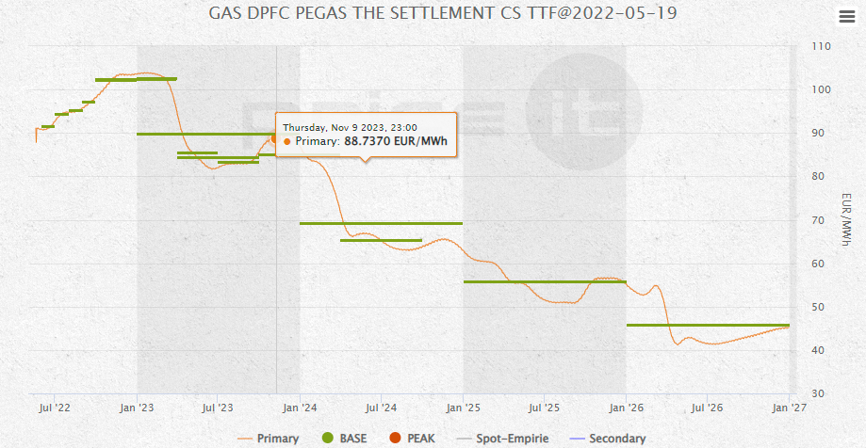
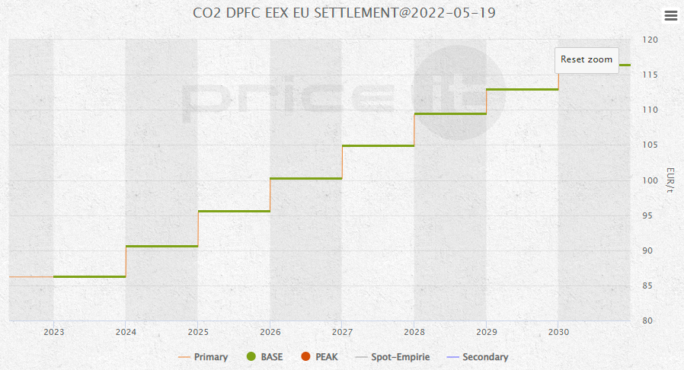
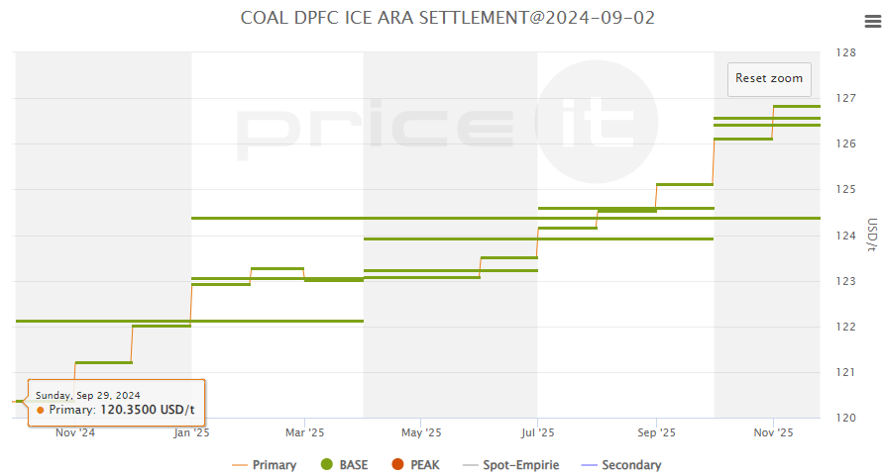
Introduction to the Markets
Why do the PFCs/markets look like that? Answer: Power isn‘t storable, Gas partially (28% of required gas in Germany), CO2 certificates, Coal and Oil are storable
Power
Gas
CO2 / COAL
Notes:
Daniel
Why do Power PFCs look like this and why is a gas or coal pfc not that volatile
Power isn‘t storable it must be consumed what causes a high volatility
Compared to Power, parts of the required gas can be stored if you have the storage infrastructure
Coal is of course storable or can be mined according to the demand
But the market is also changing for example the Norwegian PFC market has not always been as volatile as it is today.
The strong expansion of wind power and extreme drought, which meant that little hydro power could be used, had a major impact on the market.

Slide 10
Introduction to the Markets
Which factors are responsible for market movements?
consumption and supply
Direct consumption after production and strongly fluctuating consumption curves of households and industry lead to strong volatility
global radiation and wind
Feed-in of cheap, sustainable electricity (solar and wind) leads to strong downward price movement around midday (cannibalisation effect)
other commodities
Prices for gas, coal, oil and CO² certificates influence electricity prices and vice versa
technical circumstances
The shift from expensive fossil-fuelled power plants to low-cost renewable energies will have a lasting impact on pricing (merit order model)
The shutdown/start of power plants has an impact on the wholesale price
Expansion of electricity storage systems and electrolysers ensures lower volatility
Notes:
Daniel
Power must be consumed after production and because of the fluctuating consumption ist very volatile
Power can‘t be stored, only transformed (chemically (Battery), kinetic energy (Pump Storage))
Cheap sustainable energy causes prices to fall sometimes even down to negative prices
Commodities influence each other Merith order – the most expensive producer determines the price
Shutdown & start of power plants causes aditional costs
Epansion of chemical and physical storage systems and electrolysers ensure lower volatility

Slide 11
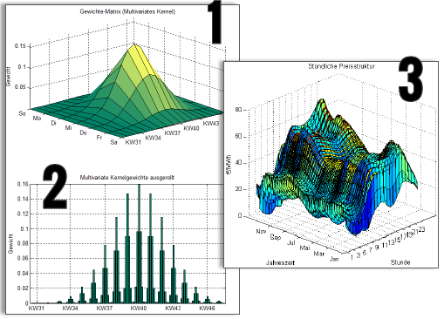
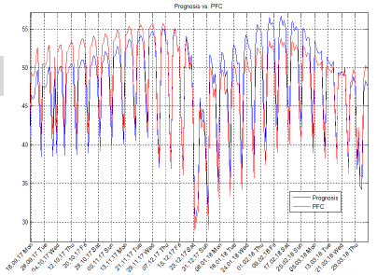
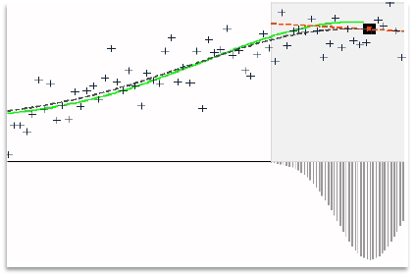
Methodologies
There are different approaches to create a PFC:
Fundamental
Use other key figures outside the actual exchange prices or assumptions about developments such as political events or weather data
Econometric
Uses only historical and current spot and futures prices and generates PFCs using regression models
Notes:
Daniel
Fundamental – use external influences like political - or extrem weather events – additionally to the actual exchange prices - it’s a more speculative way
Econometric – our way: historical & current spot prices and using regression models

Slide 12
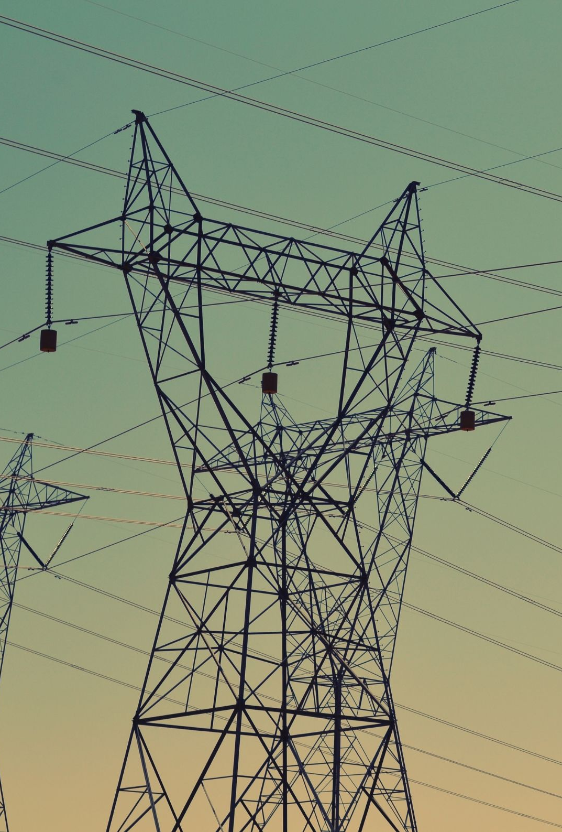
MONTEL RISK
Methodologies
Introduction to the Markets
A good PFC should be …
1. … free of arbitrage
Otherwise the cascading of the future prices would not work
2. … a good expectation for spot price shapes
We use techniques from modern pattern recognition
3. … stable from curve to curve -> Keep out jumps from the portfolio
Typically, long run expectations do not change extremely from one day to another
Serious risk management needs stable measurements (taking care of limits etc.)
4. … “smooth” from day to day, month to month…
…taking care of smoothness with regularization algorithms
Which factors are responsible for market movements?
consumption and supply
Direct consumption after production and strongly fluctuating consumption curves of households and industry lead to strong volatility
global radiation and wind
Feed-in of cheap, sustainable electricity (solar and wind) leads to strong downward price movement around midday (cannibalisation effect)
other commodities
Prices for gas, coal, oil and CO² certificates influence electricity prices and vice versa
technical circumstances
The shutdown/start of power plants has an impact on the wholesale price
Expansion of electricity storage systems and electrolysers ensures lower volatility
The shift from expensive fossil-fuelled power plants to low-cost renewable energies will have a lasting impact on pricing (merit order model)
Notes:
Daniel
1- the cascading of the future prices would not work
2 for example ou can youse techniques from modern pattern recognition
3 – the shouldbe no spikes or outliers from one day to the next – long run expectations do not change extremely fron one day to the other – risk management needs stable measurements
4 –smooth transition between months, quarters and years

Slide 13
Use case
Portfolio Management
Consulting Companies
Energy consultants support their clients in topics such as risk and portfolio management, energy procurement, tenders, etc. For all these topics, a PFC is almost always used to create a valuation.
Risk Management
The risk management department of a Power Utility is using a PFC to quantify price risks (because of a volatile market). These risks will be communicated to the Sales Department to add an surcharge in their offers for the customers.
Price-Forward-Curve (PFC) is a cross-departmental key instrument.
Industrial Customer
The portfolio management of a Energy Supplier is using a PFC to valuate assets (plants, solar and wind parks) and to optimise them in long term.
Industrial customers often buy their energy in tranches at several points in the year. They need PFCs to evaluate their load profiles and to cross-check their energy suppliers.
Notes:
Maik

Slide 14
Characteristics PFC
PFCs should be always free of arbitrage (price differences of the stock products)
Alarm system: if an error is detected on the exchange, a warning will be sent to the customer, the error will be solved and the data will be recalculated
Regulary updates and improvements of calculation models and products
High grade of customizability - providing the PFC the customer needs/wants
Contains Multi-level quality management (also human quality management)
A PFC is often the basis for further technical valuation approaches and trading strategies
Notes:
Daniel
From our perspective the characteristic of a good PFC should be….
6- PFC hast to be reliable so it can be the basis for further valuatiions approchaes and trading strategies

Slide 15

FAQ
Is a PFC a Forecast? No, a PFC is a market representation.
Whats the time horizon of a PFC? It depends on the market hub, on the exchange and it‘s liquidity In general 2-10 years.
Are there regional differences?
Power: The most countries in Europe have their own Market Hub. Besides that, some countries are also divided into zones (Norway, Italy, Sweden…)
Gas: The market hubs are organised in zones (e.g. THE, TTF, ZTP)
What data are the PFCs based on? PFCs based on the data provided by the exchanges. For some countries there is data from multiple exchanges (EEX, ICE, Nordpool, OMIP)
Notes:
Daniel und Maik
Maik Startet

Slide 16

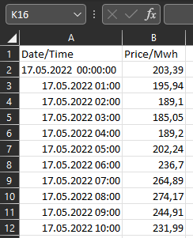
FAQ
How do PFCs differ?
PFCs can differ depending on the data provided by the exchange, e.g. in length, volatility and availability of base and peak products.
How does a PFC look like as data?
(.csv or .xlsx)
How do I receive PFCs and use them?
You can receive it via Mail, FTP Server, API or other possibilities and use it in you ETRM, PMS or Excel
Notes:
Daniel und Maik
Daniel macht die letzten zwei

Slide 17
Service
Software
Consulting
PFCs are just the beginning
Service
Software
Consulting
Simulations
Gas, Power, CO2, Coal (X-Commodity)
Spot (daily, hourly, quarter hourly)
Temperature dependent Gas Simulations
Forecasting
EPEX-DA/ID15-Power
Power Plant and Storage Optimisation
PFC-Builder
PFC-Builder for power & gas
Intraday/Settlement
GUI/Headless
Simulation-Builder
Seasonality Analysis
Model Calibration
Simulation
Software as a service
Hedgetool incl. Risk-Analysis
Akt: Tranches and „Rehedge“
Price Forward Curves (PFCs)
Risk-Analysis (PaR, VaR, etc.)
Investment Valuation
Stochastic Price Models
(Real-) Option Valuation with SDP
Notes:
Daniel und Maik
Daniel Startet
Maik macht Software und Consulting

Slide 18
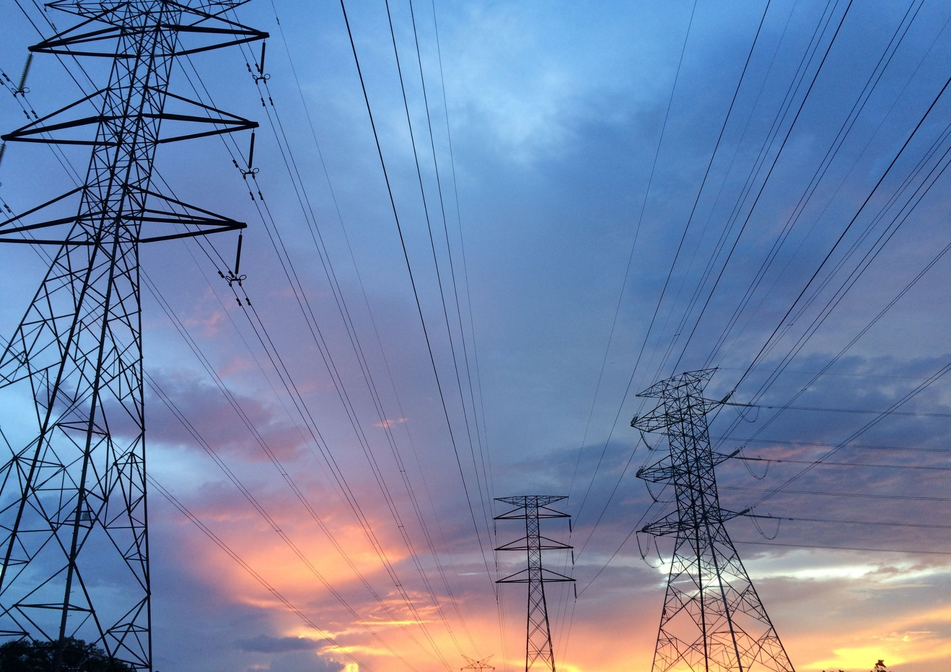
Maik Bräuer
Sales | Projects
Daniel Gehardt
Sales Manager
Mail: price-it.sales@montelgroup.com
Thank you for your attention
Notes:
Daniel
Thank you all for participating in this webinar.
We will send you the presentation and all questions + answers in a follow-up mail.
If there are any further questions or if you are interested in a personal meeting, a free trial of a PFCs. Or if you are interested in a deeper insight into the topic.
Please feel free to write to us at the email address provided or follow the links in the follow-up mail

